Slide 1
Decay the first 2 and the last 2 timepoints
Compare the decay rate with to get the adjusted pairwise p-value comparison
Early decay and late decay
Early
Late
8
60
14
28
Day

Slide 2
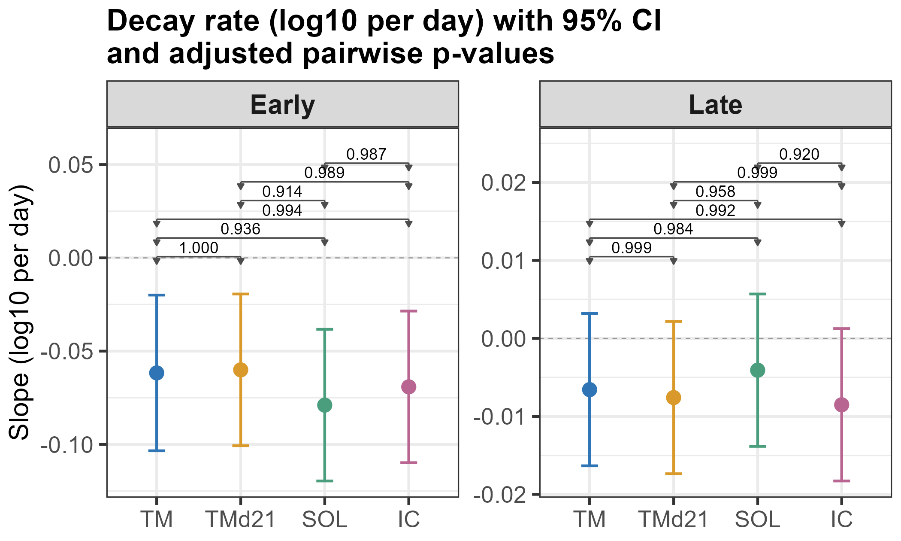
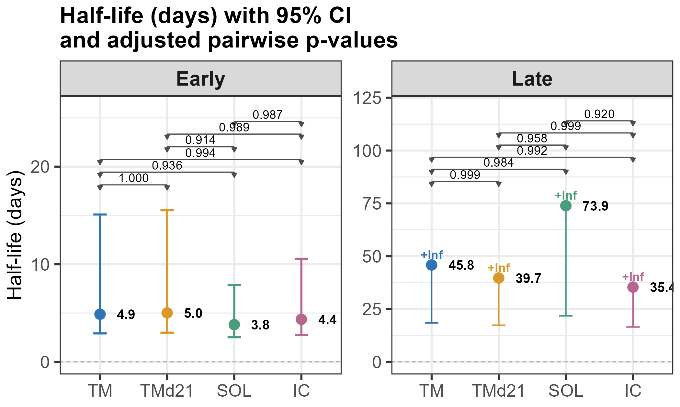
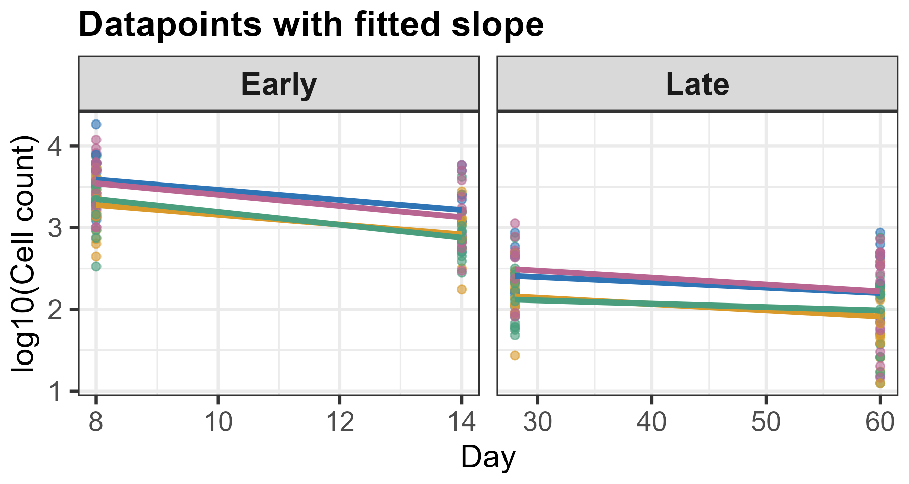
CD8 Tet+

Slide 3
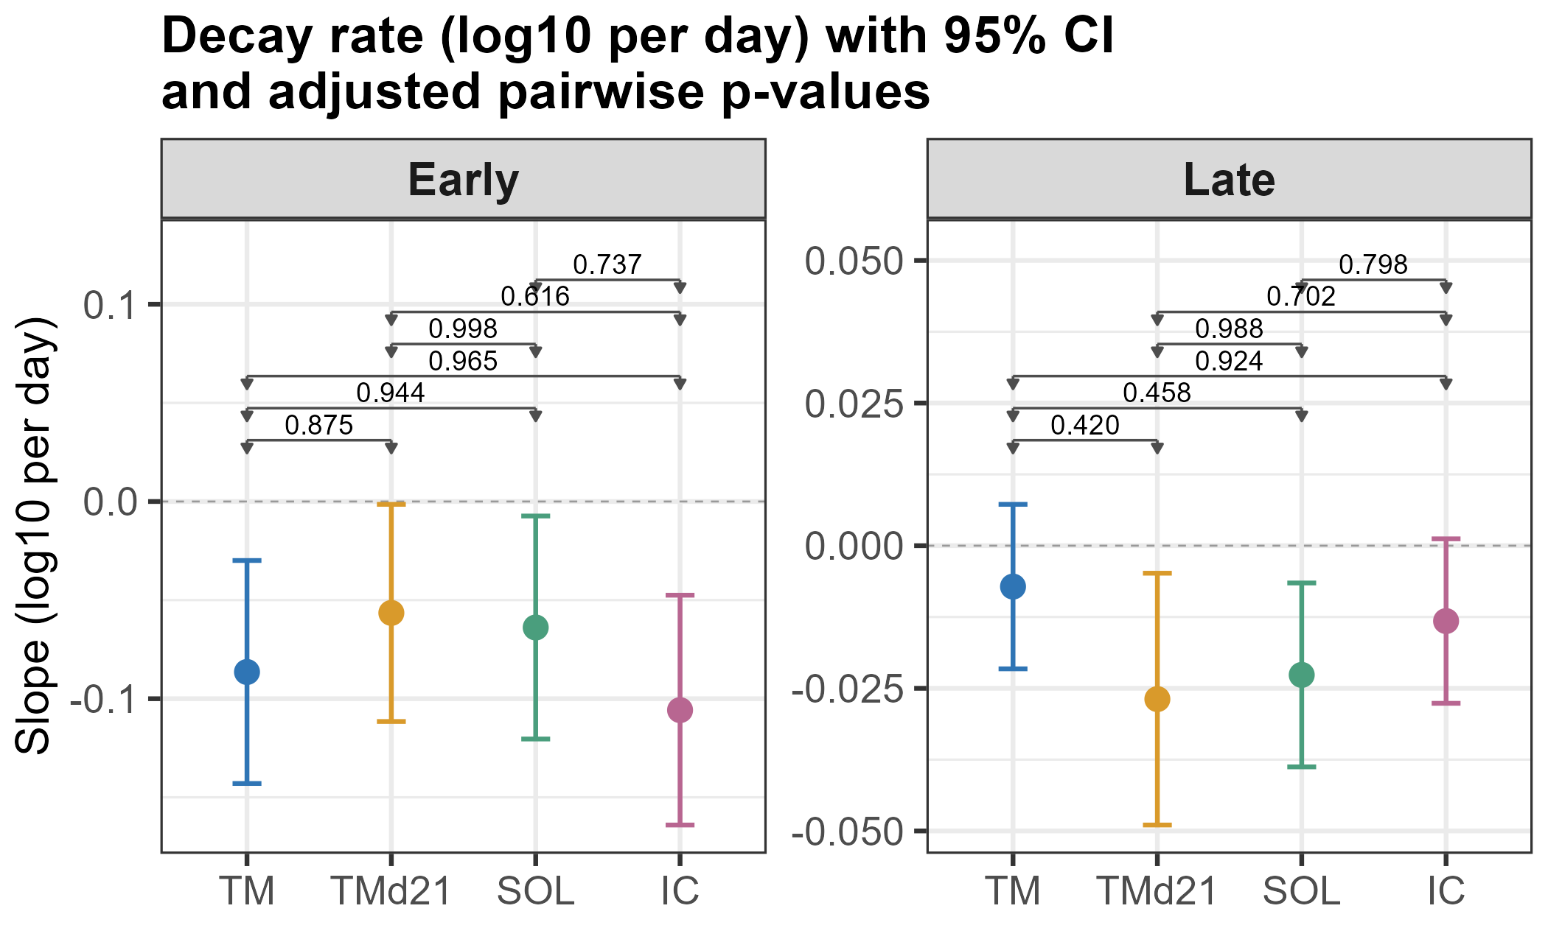
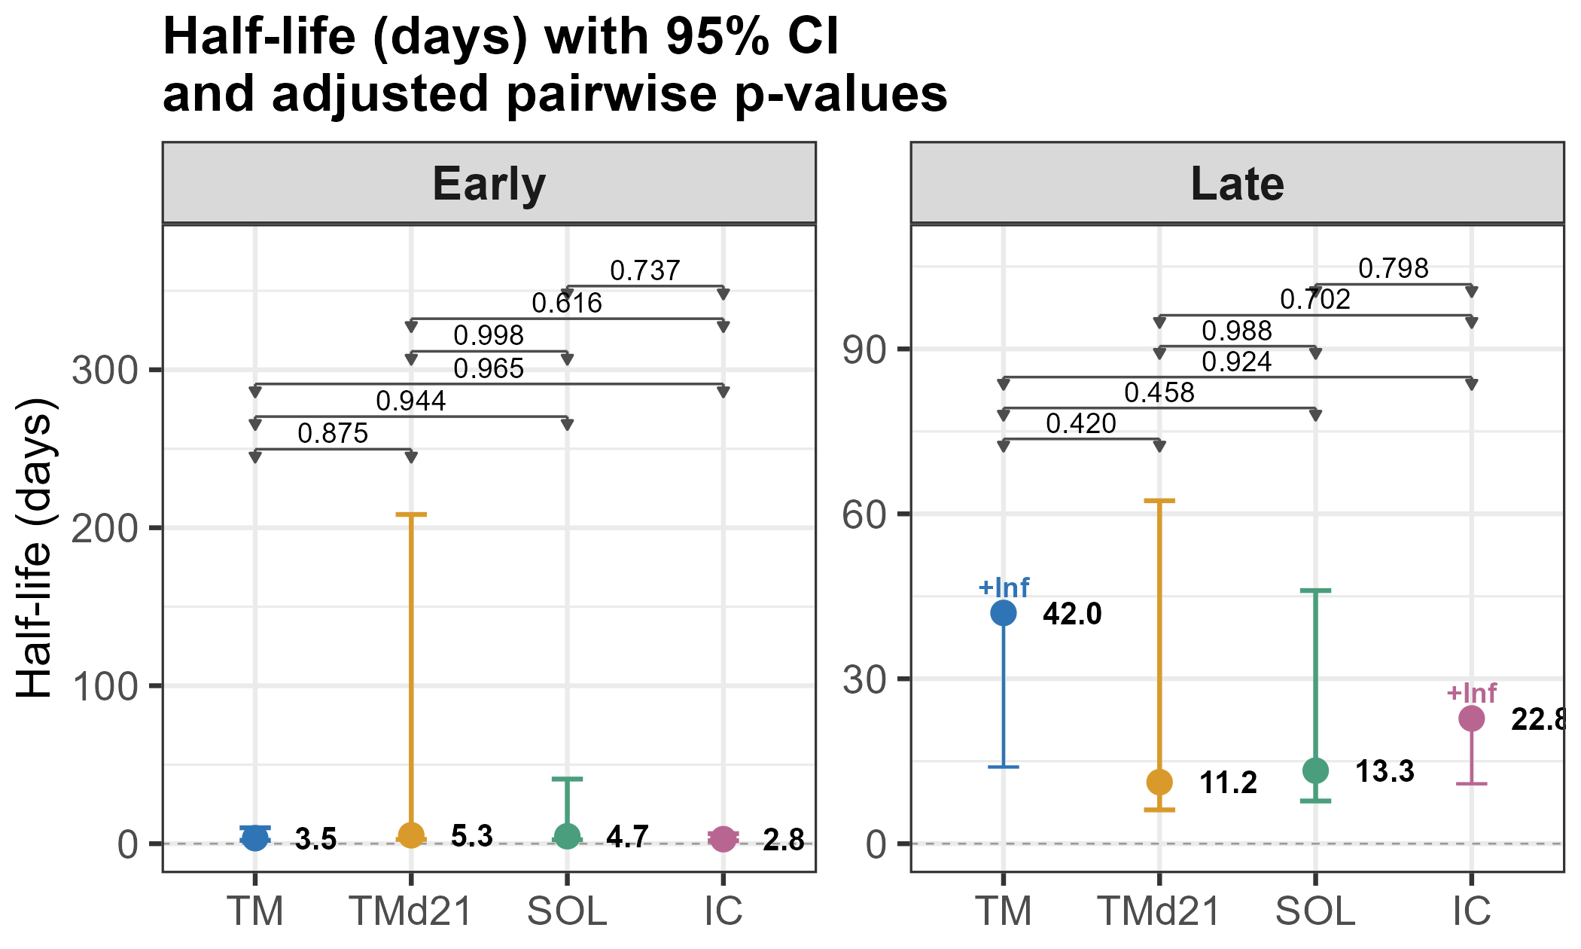
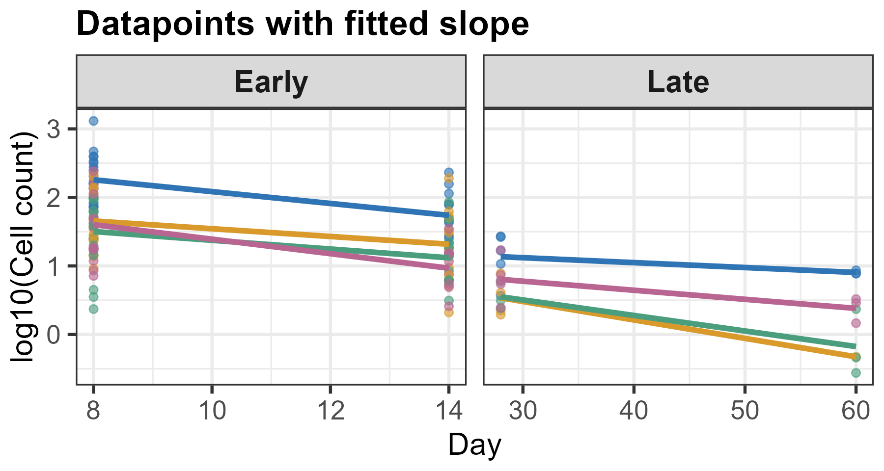
CD8 Tet+ KLRG1+ CD127- effector

Slide 4
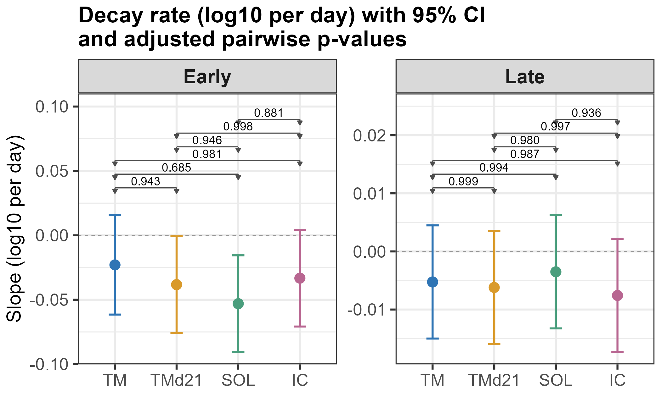
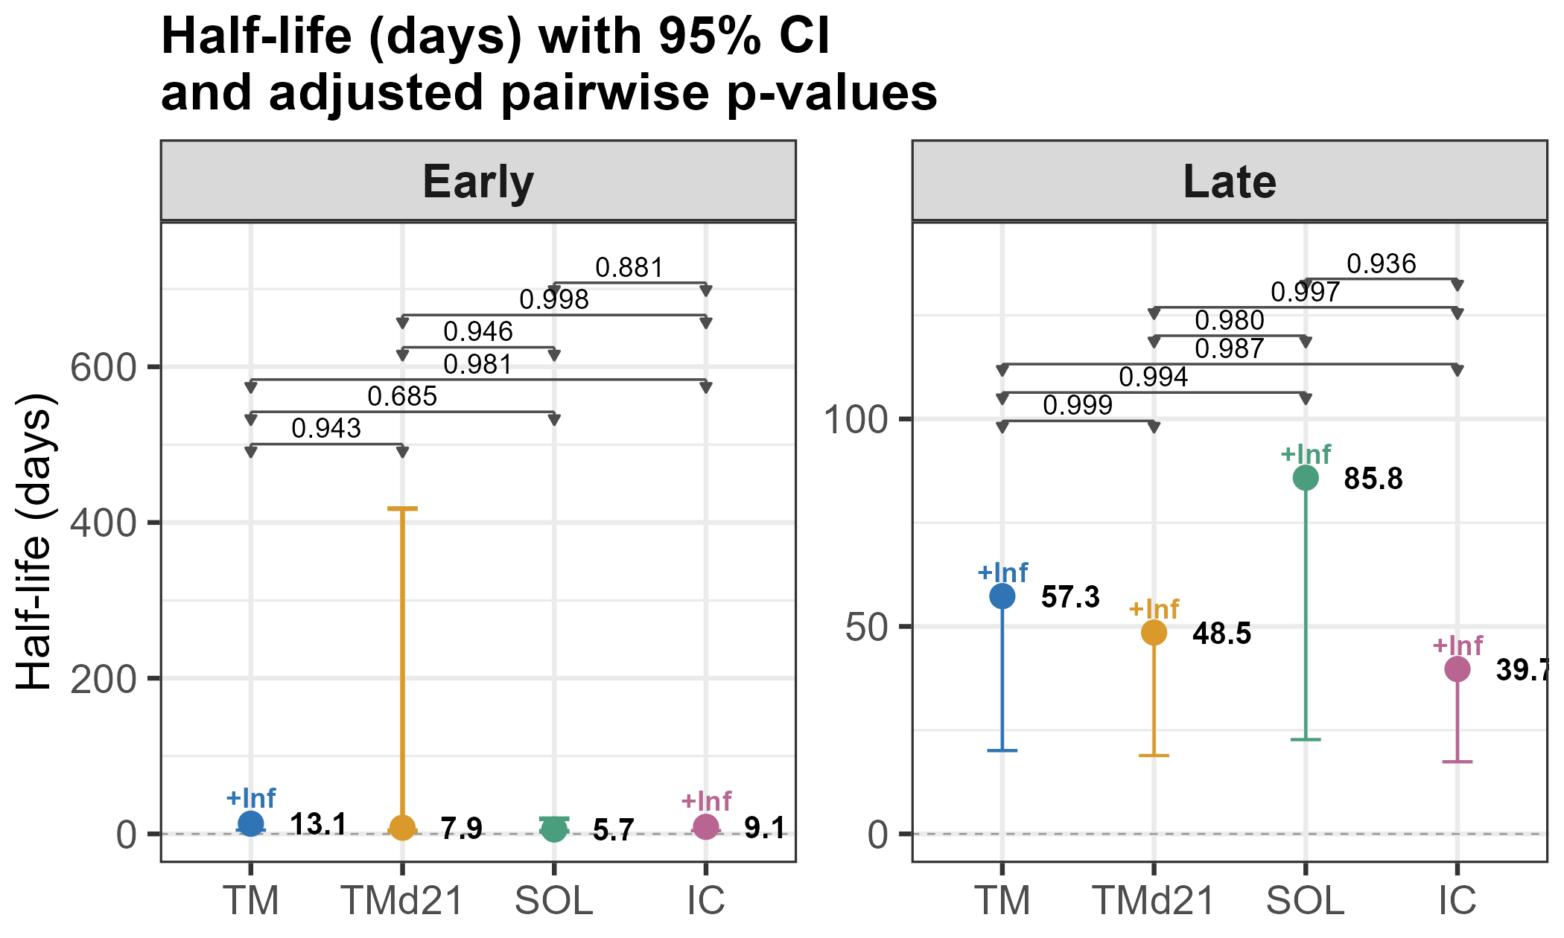
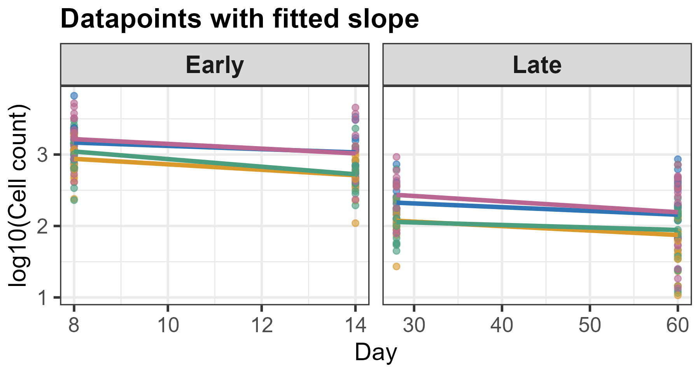
CD8 Tet+ CD127+ KLRG1- memory

Slide 5
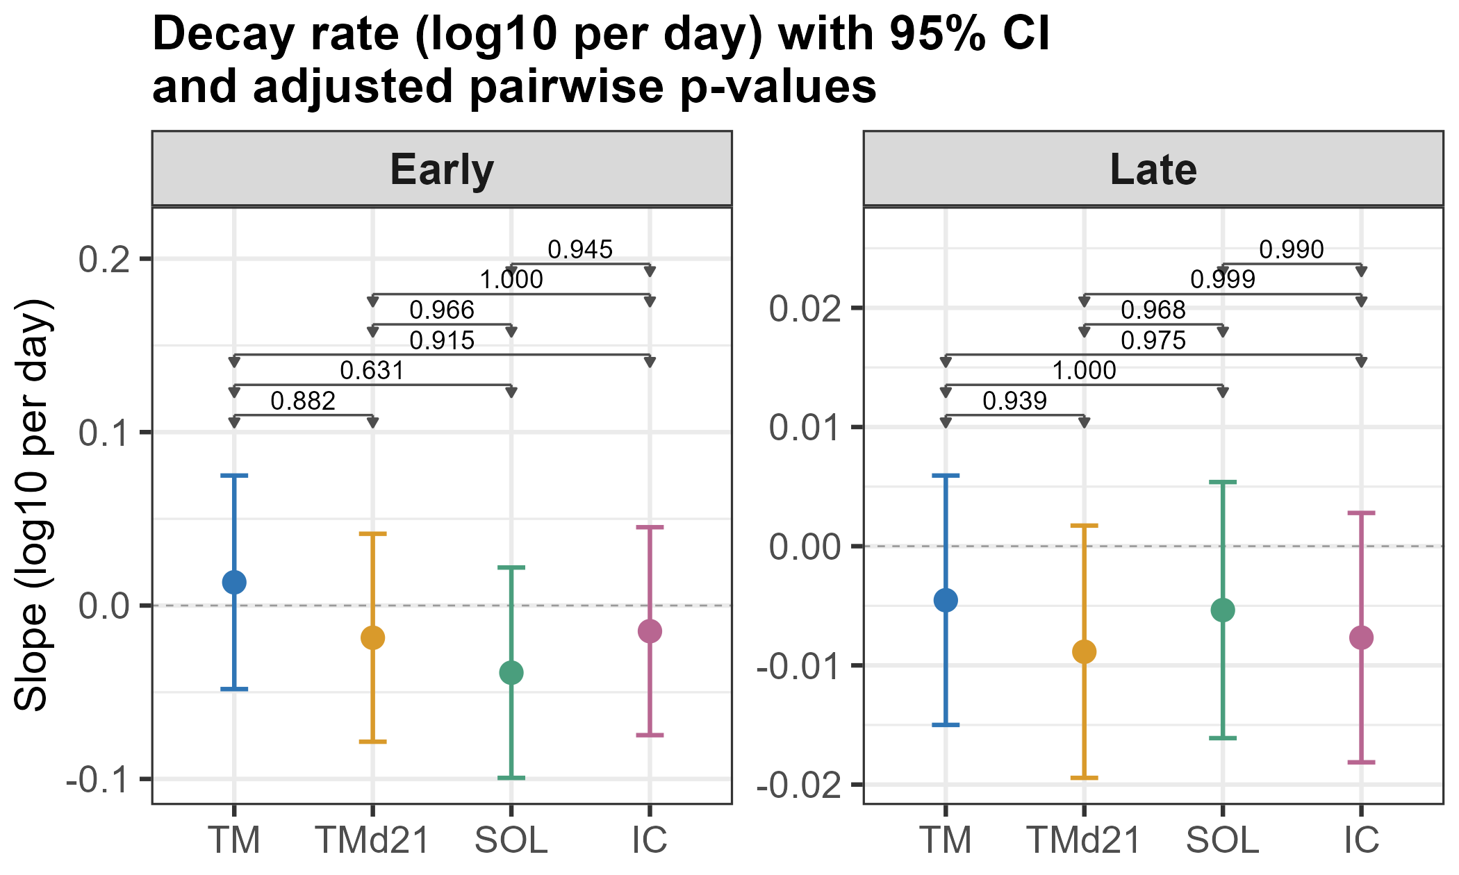
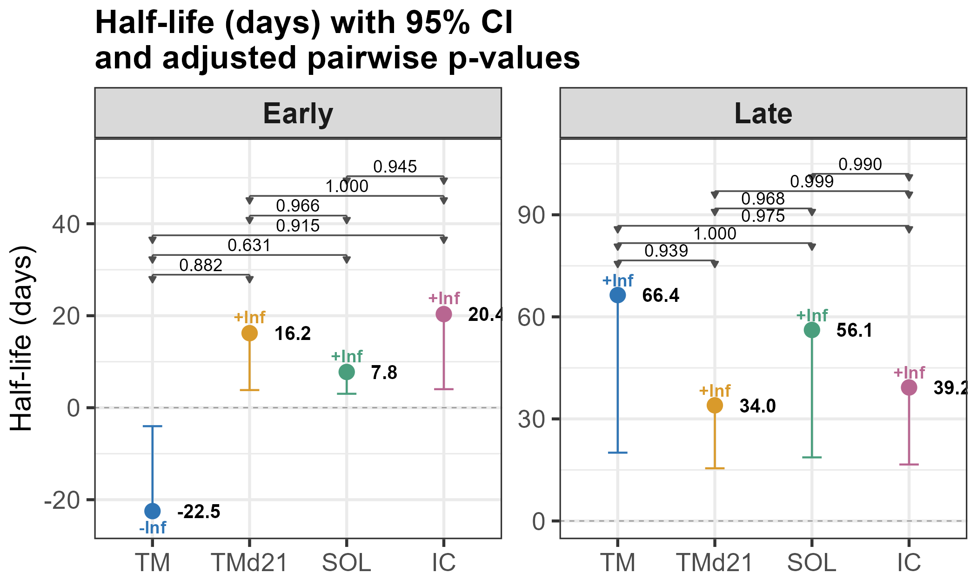
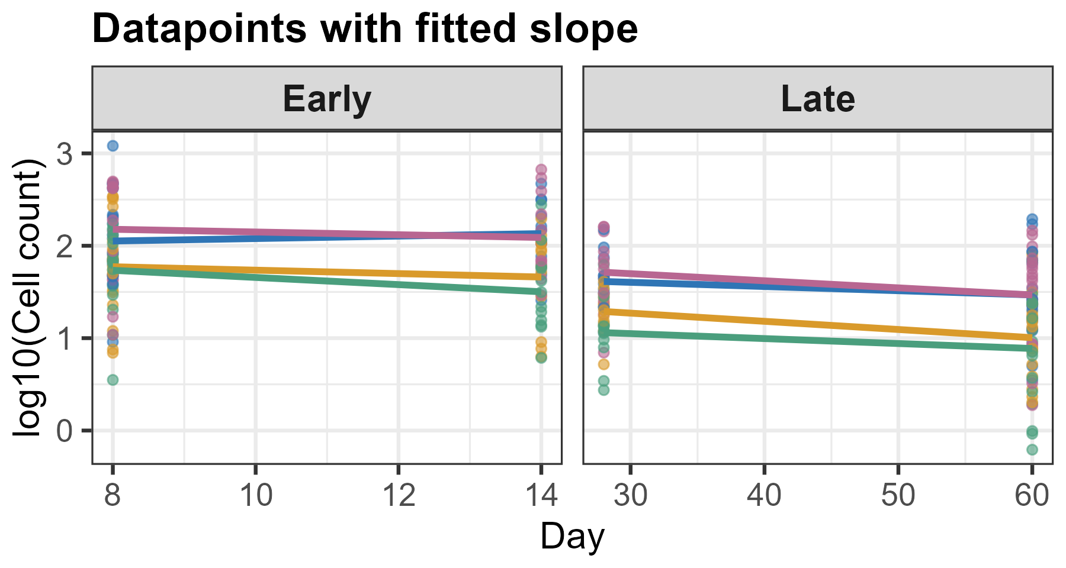
CD8 Tet+ CD62L- CX3CR1hi TEM

Slide 6
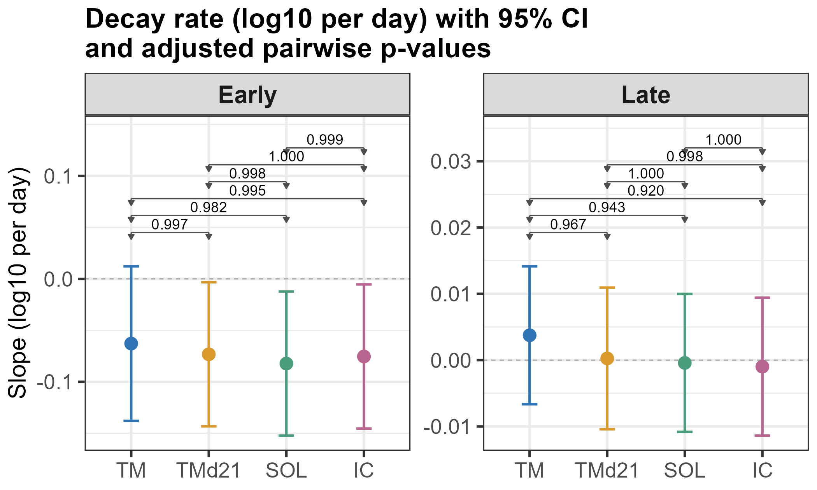
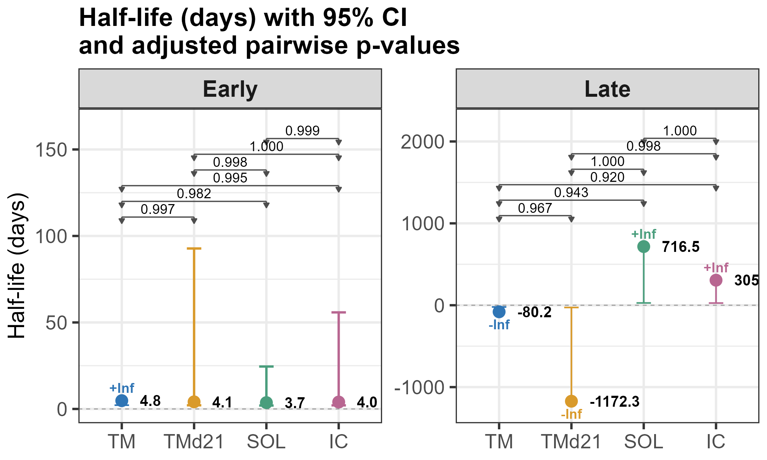
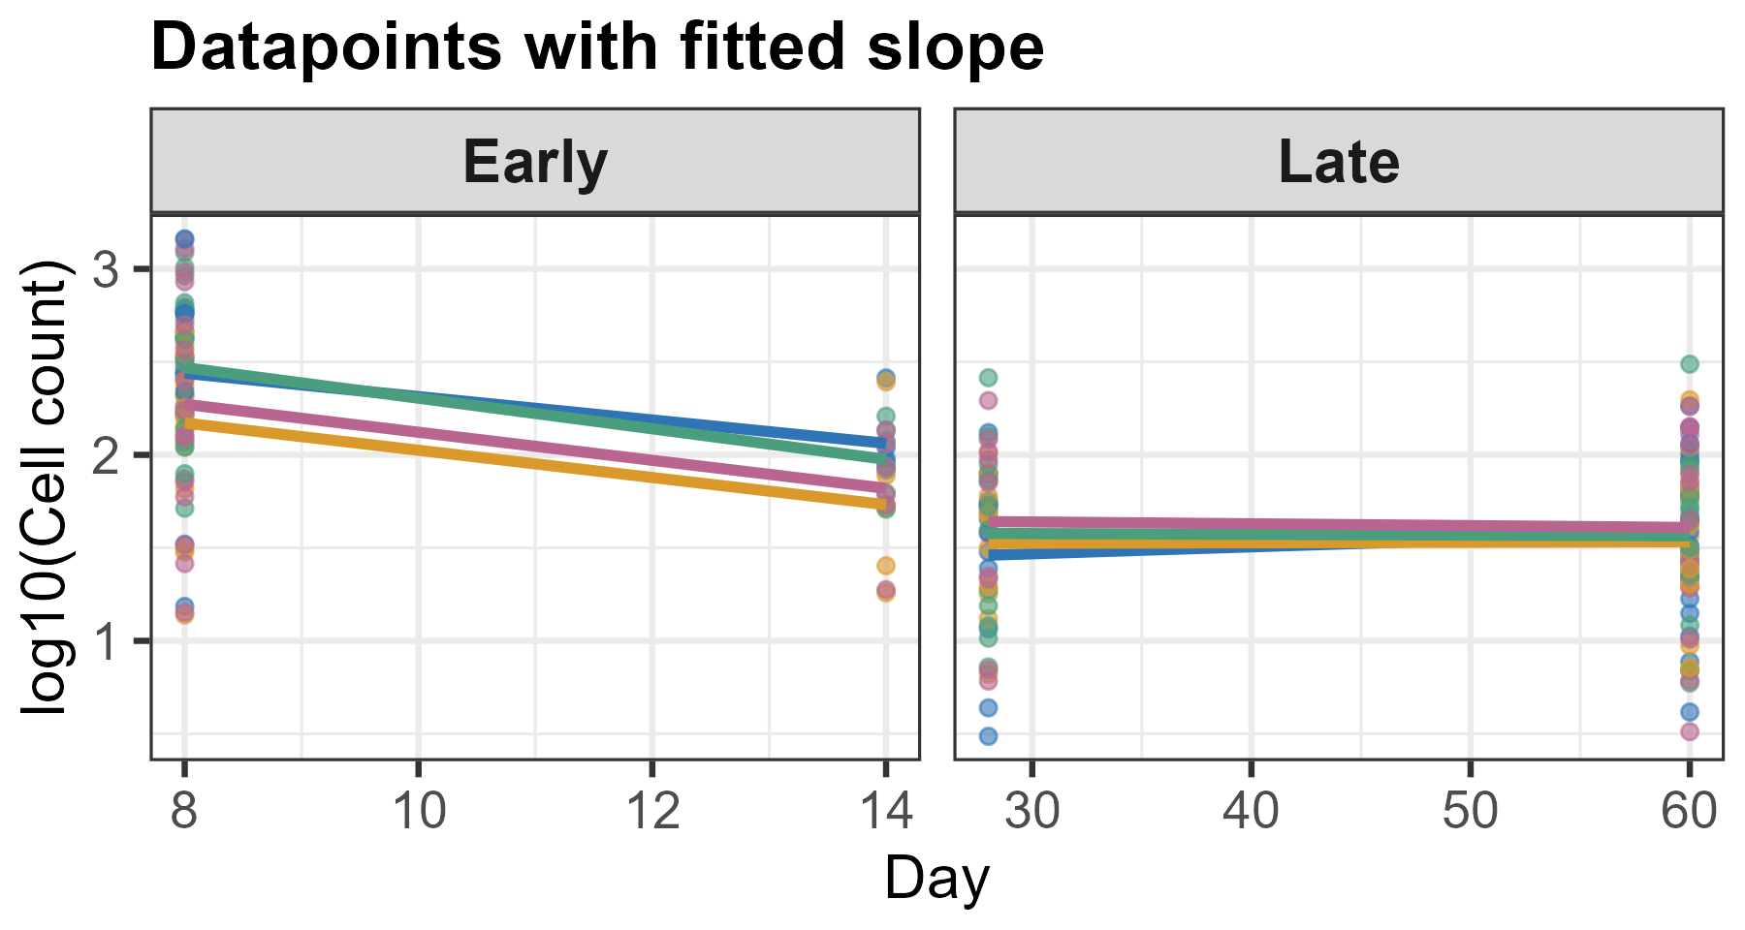
CD8 Tet+ CD127+ CD62L+ CX3CR1- KLRG1- TCM

Slide 7
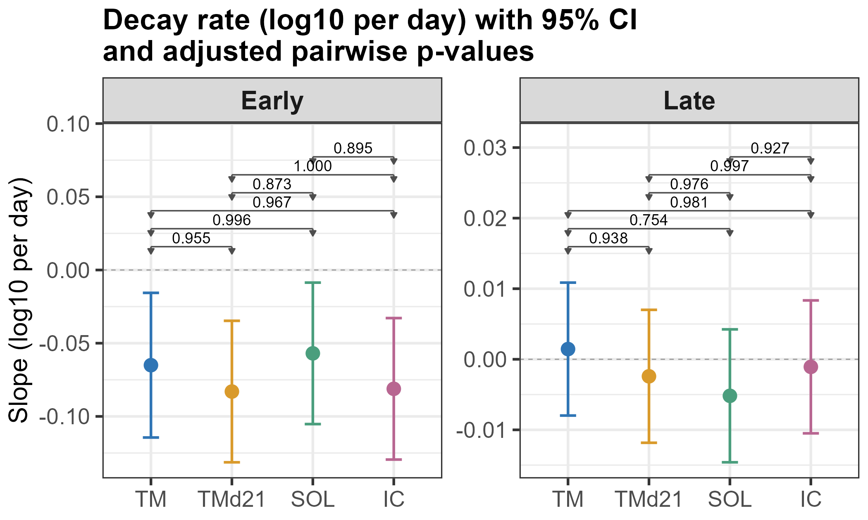
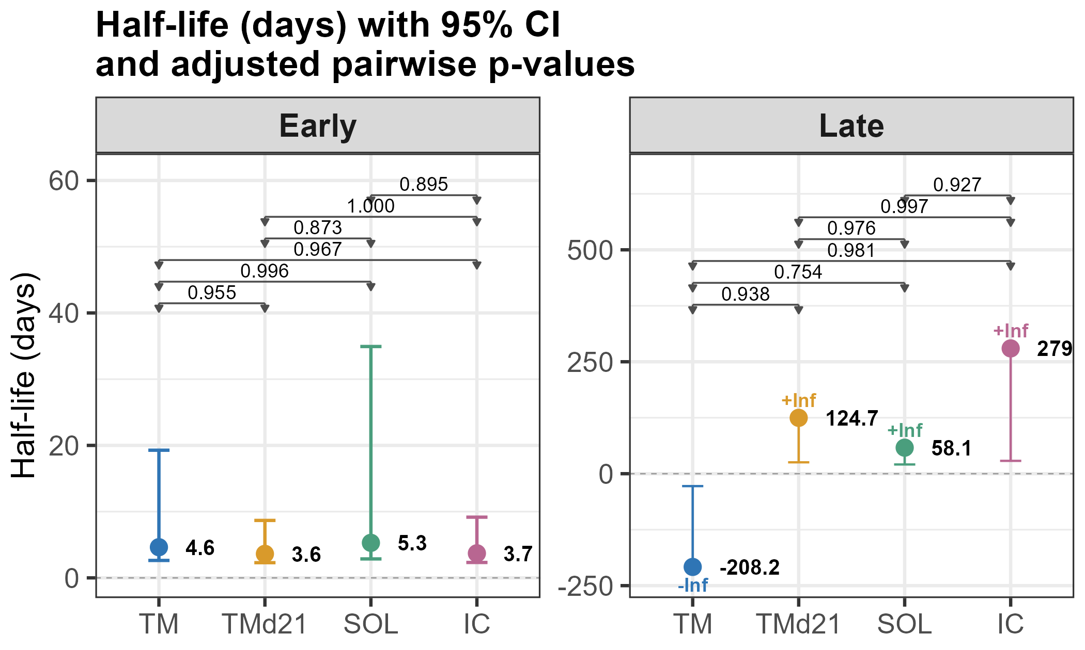
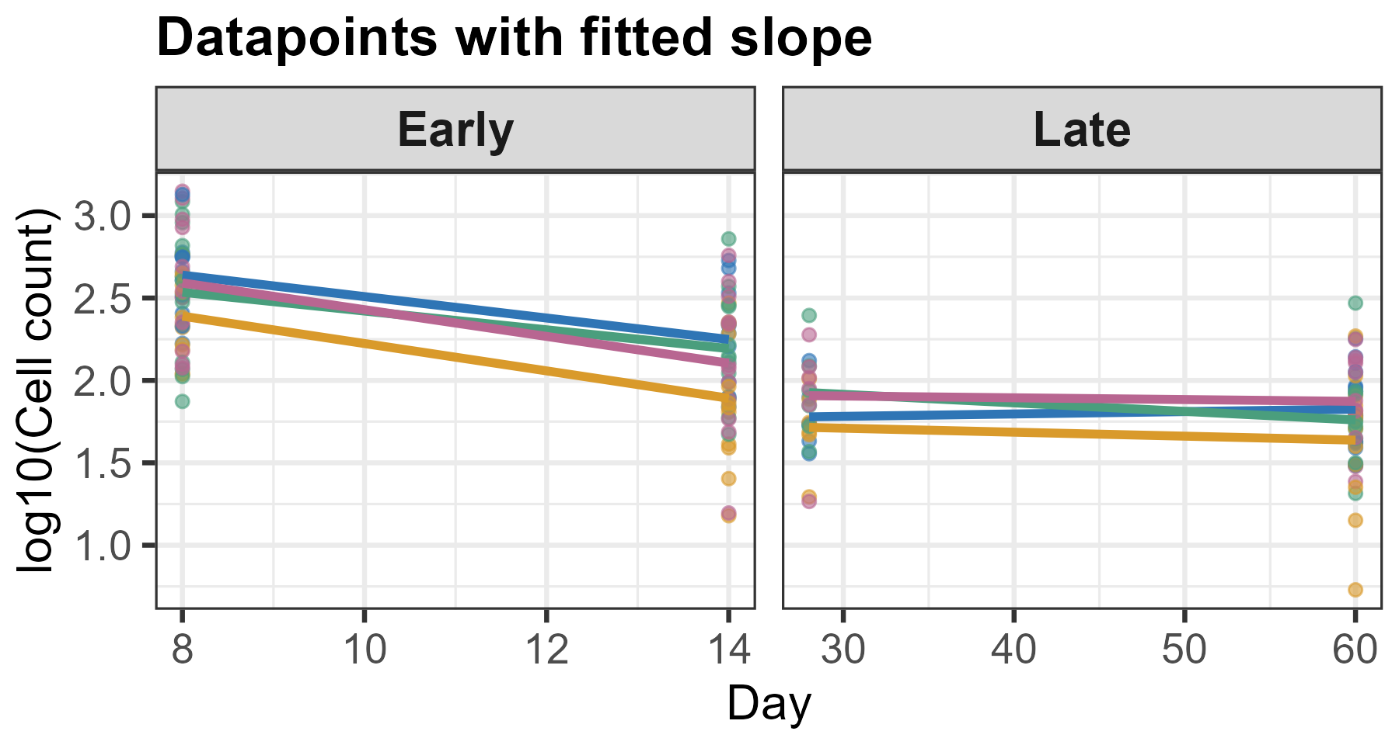
CD8 Tet+ CD127+ KLRG1- TCF1+ SLAMF6+ Tscm

Slide 8
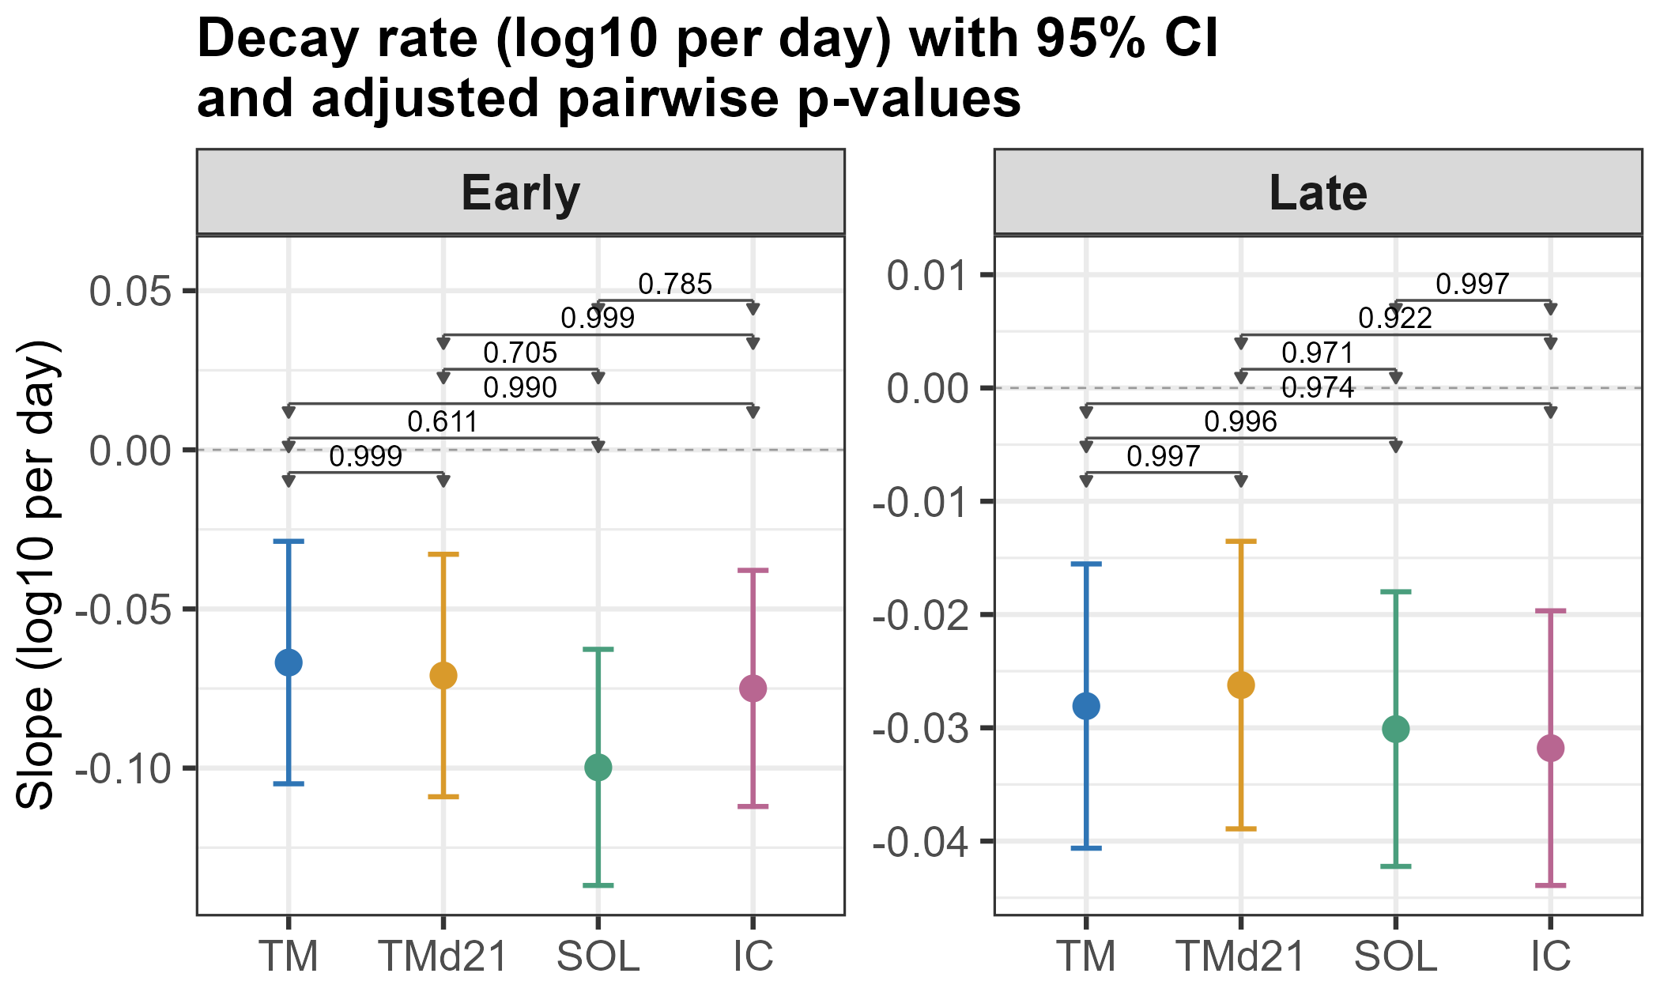
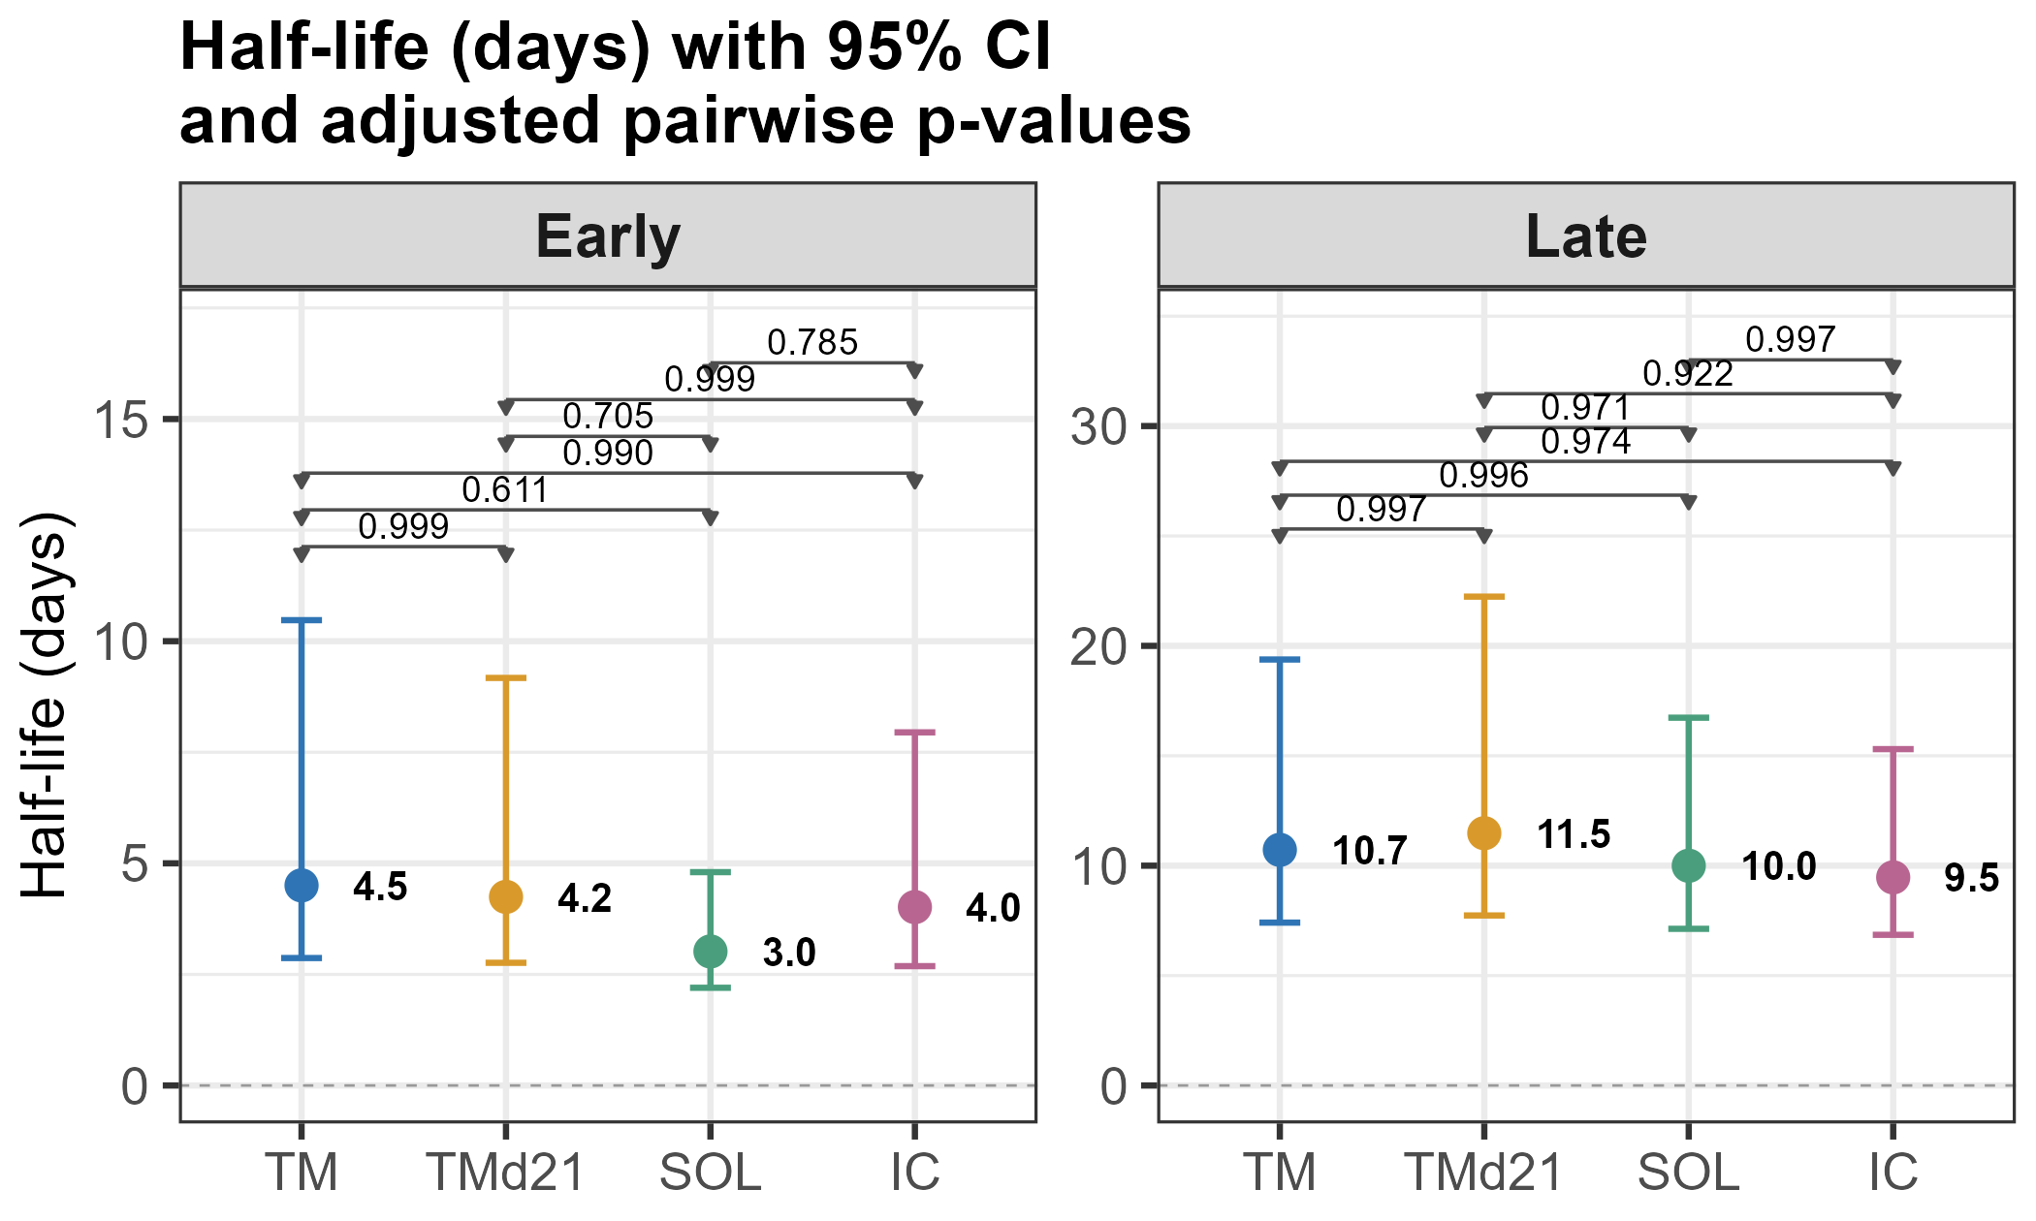
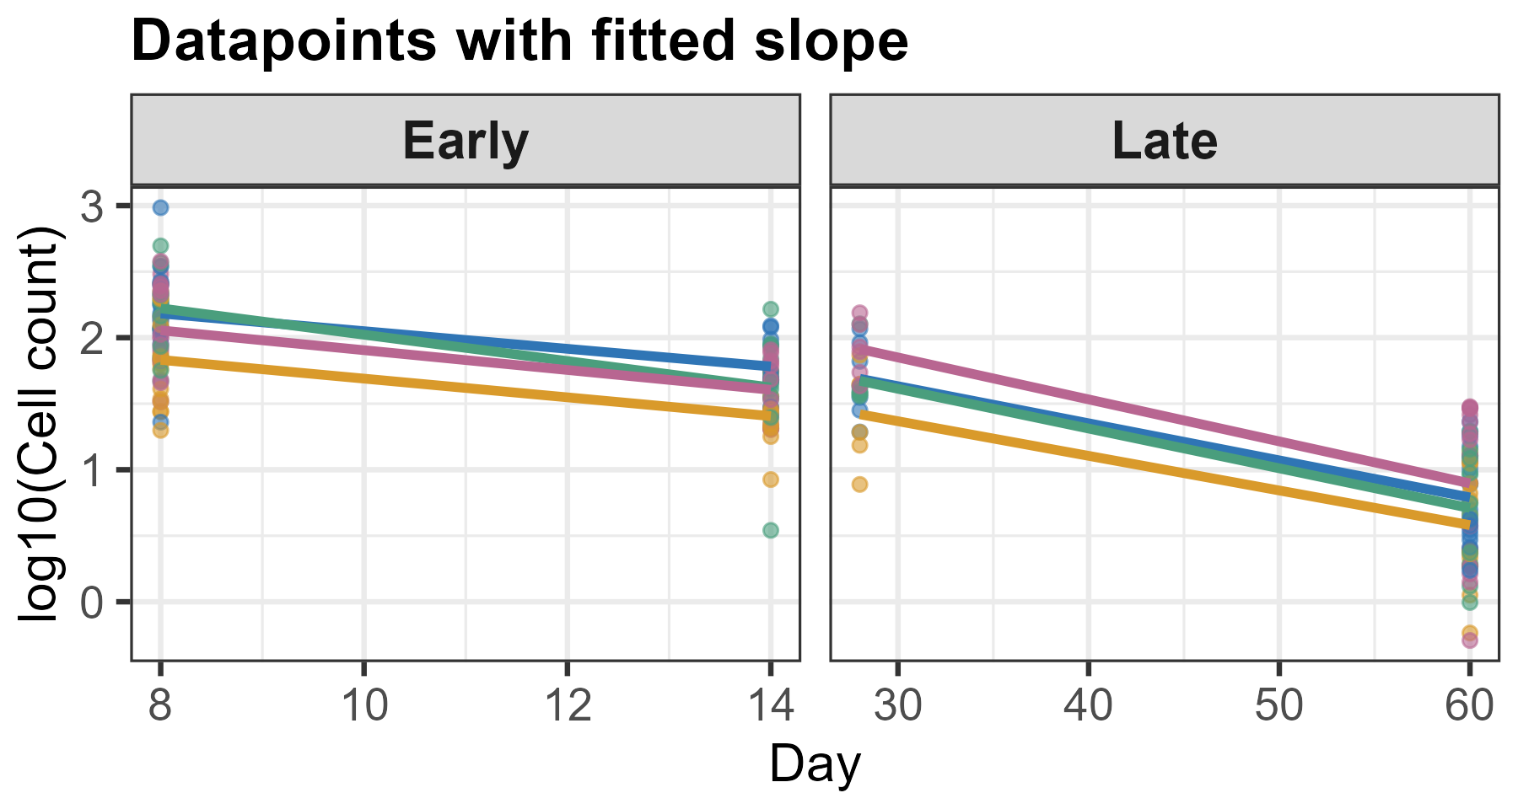
CD8 Tet+ CXCR5+ PD1+ CD127+ KLRG-1 TFHlike

Slide 9
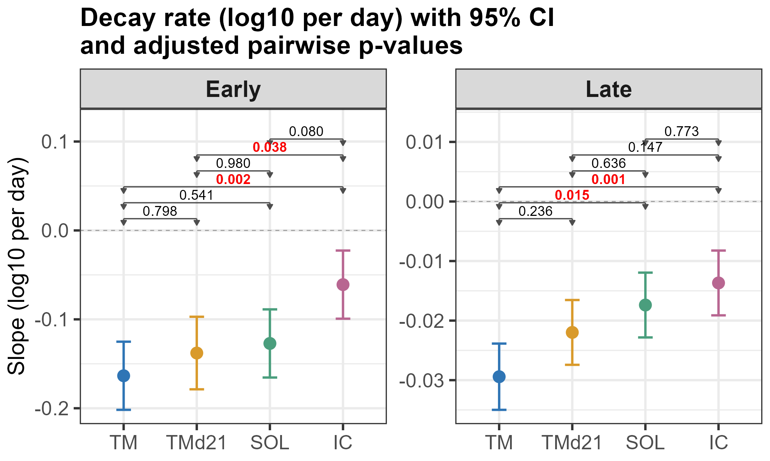
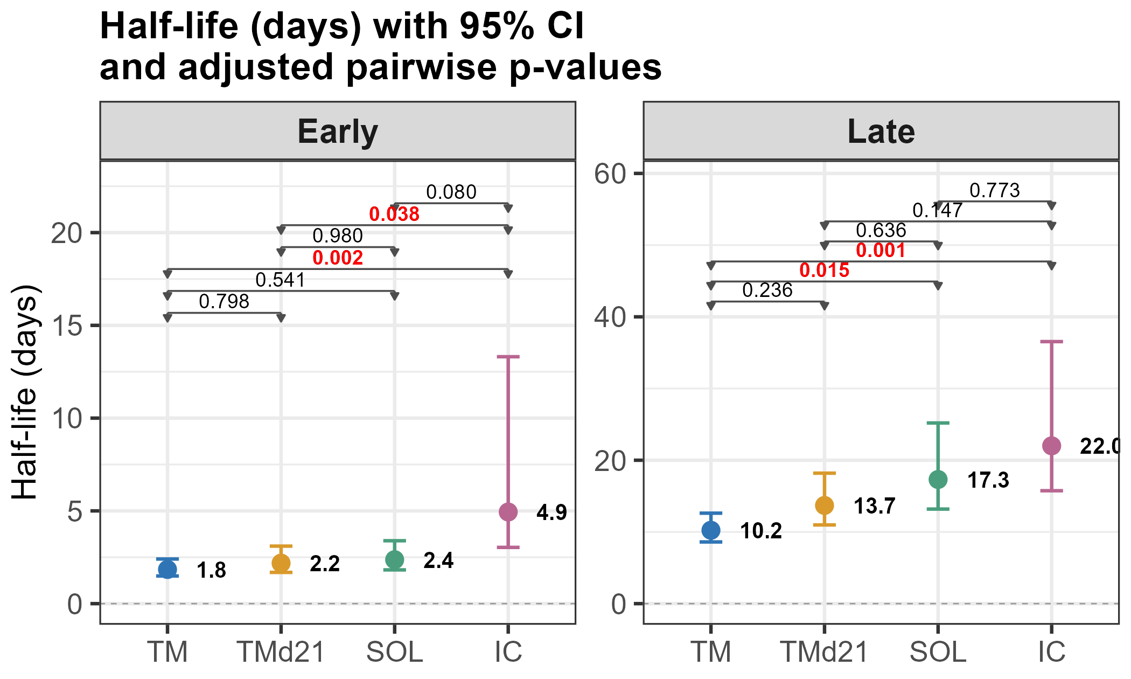
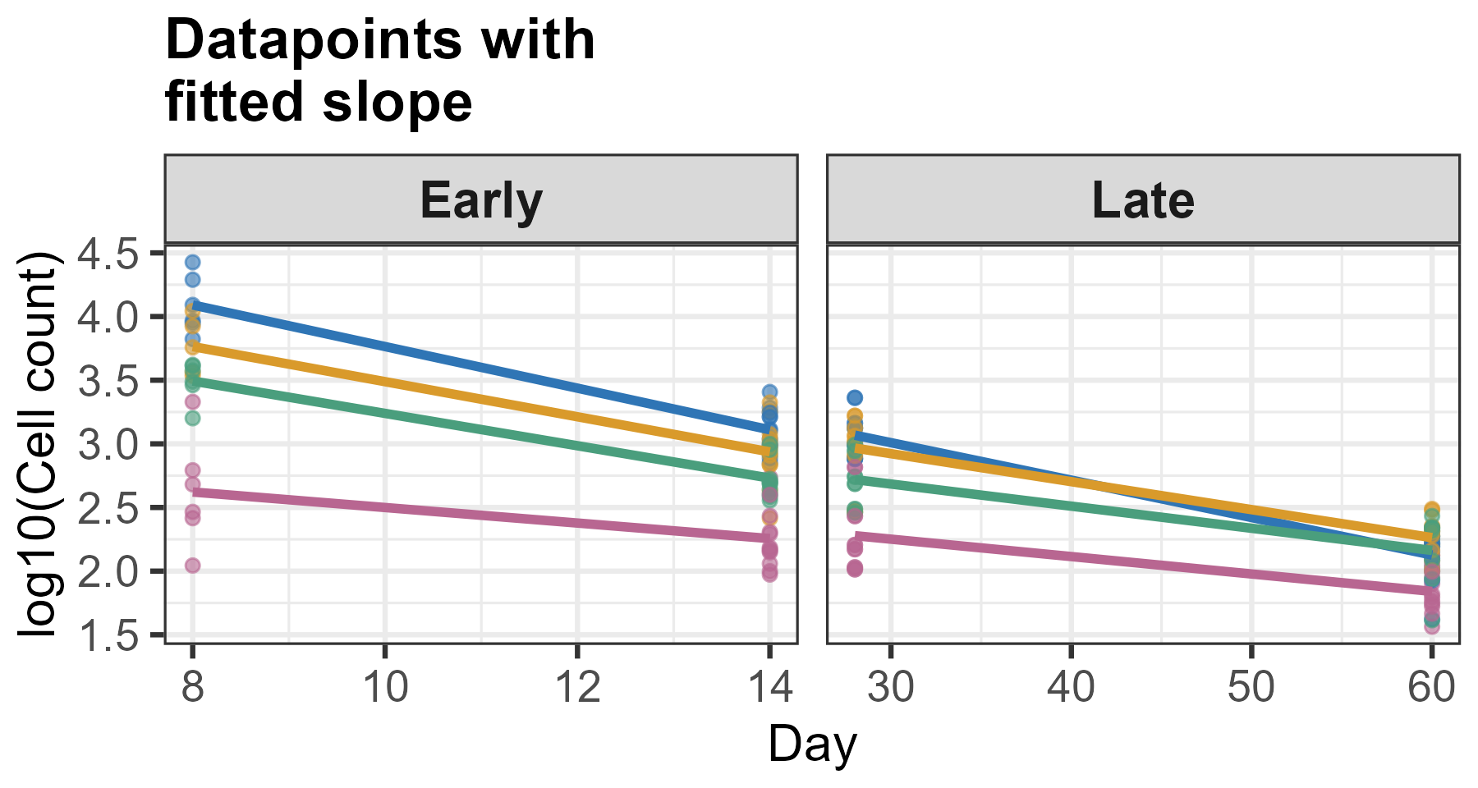
CD4 tet+
Early decay:
TM vs IC
Tmd21 vs IC
Late decay:
TM vs SOL
TM vs IC

Slide 10
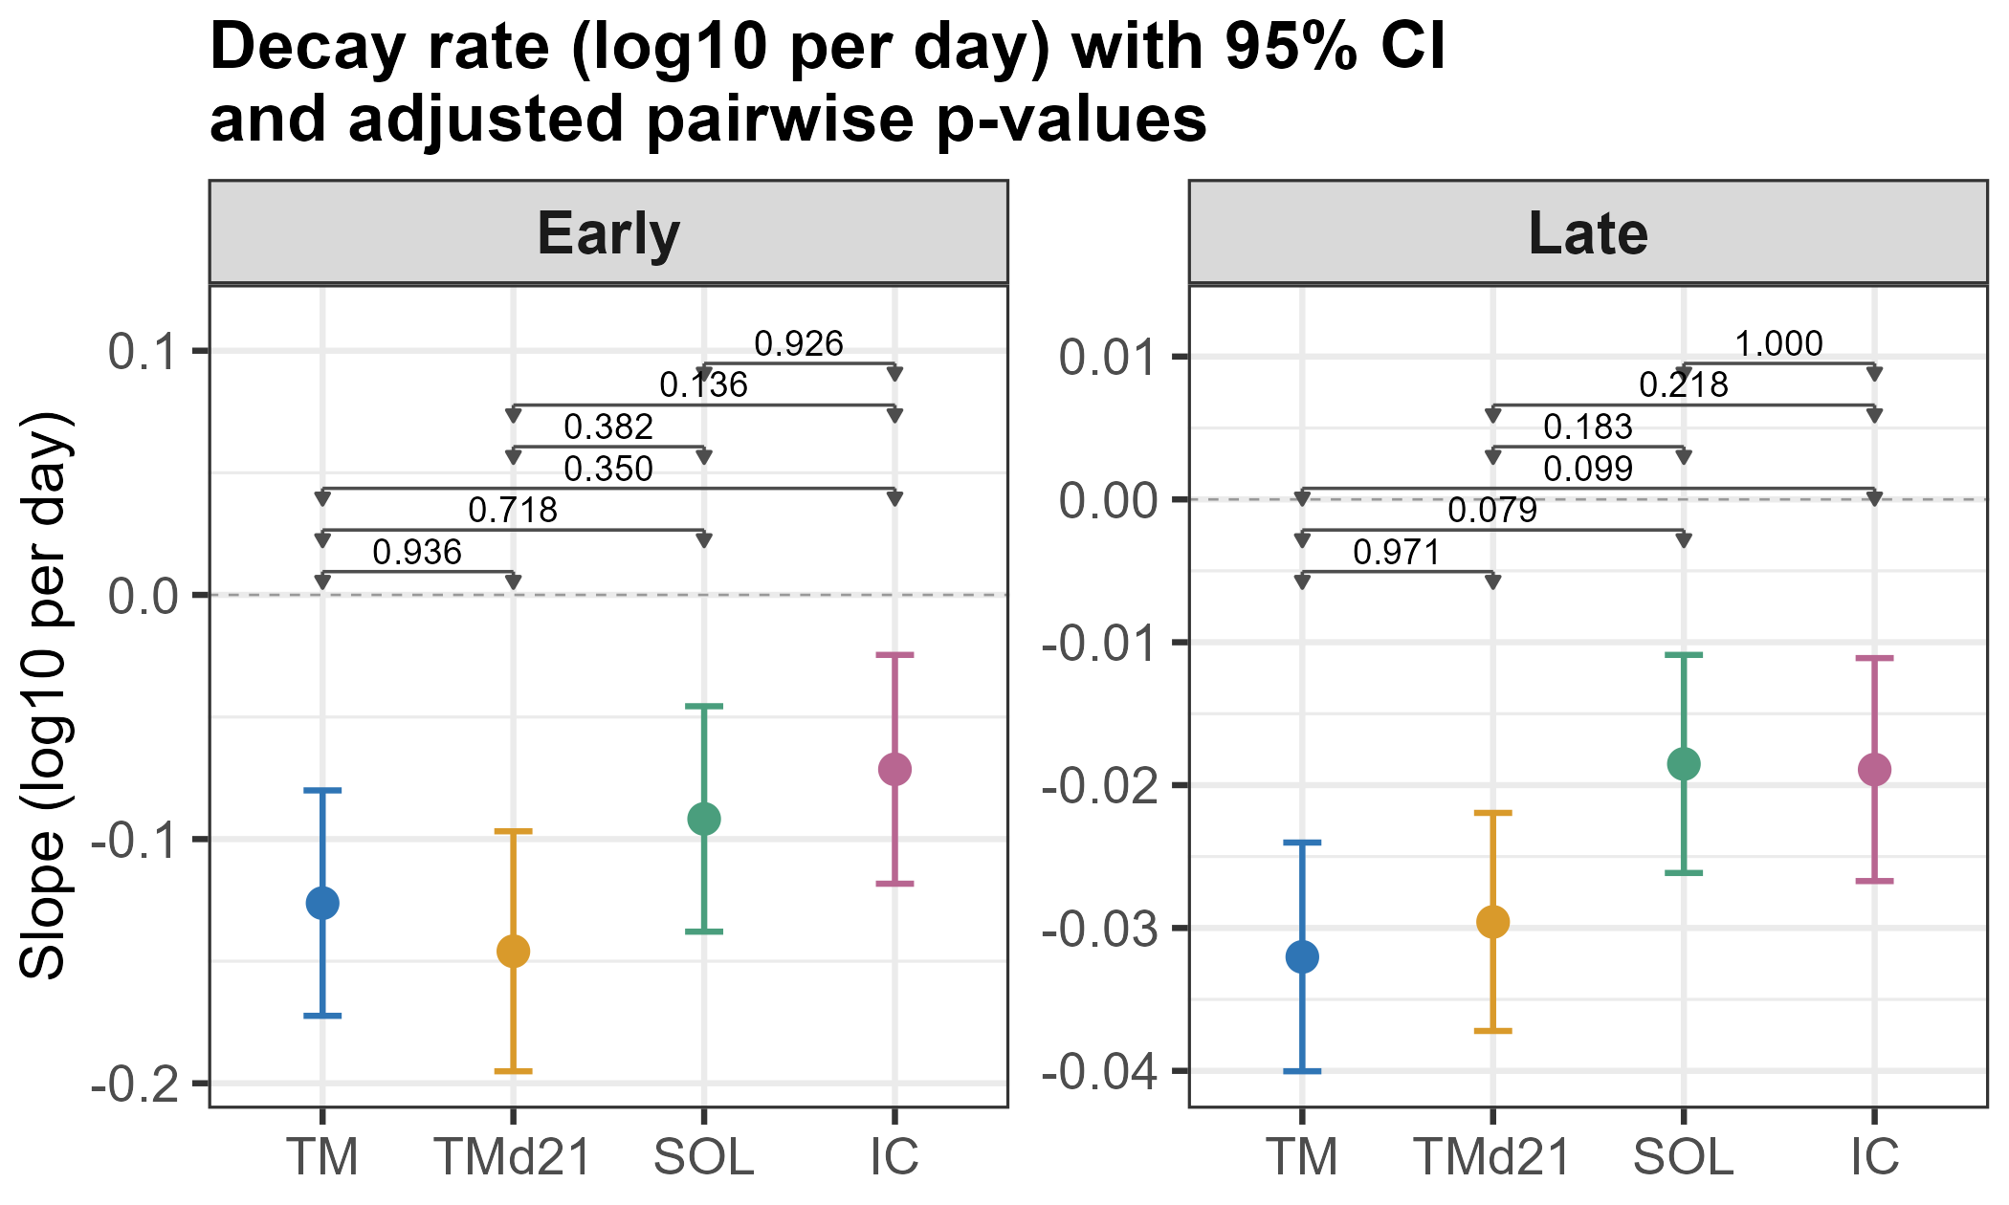
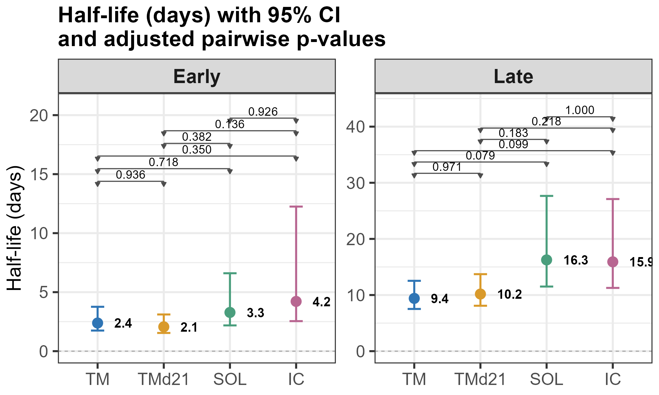
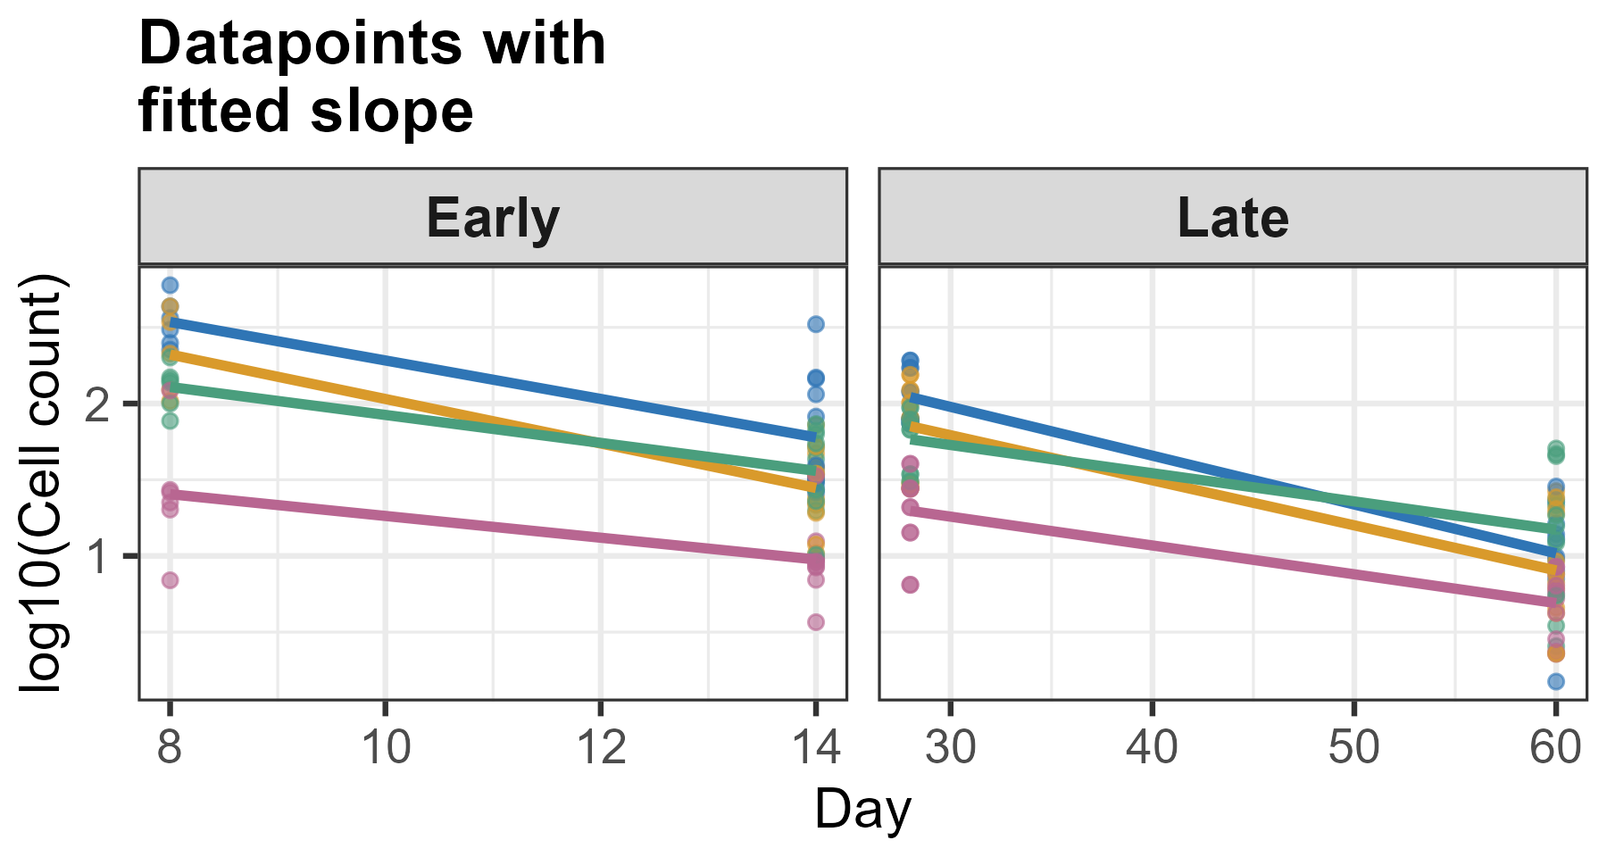
CD4 tet+ Ly6C FOXP3 Teff_cells

Slide 11
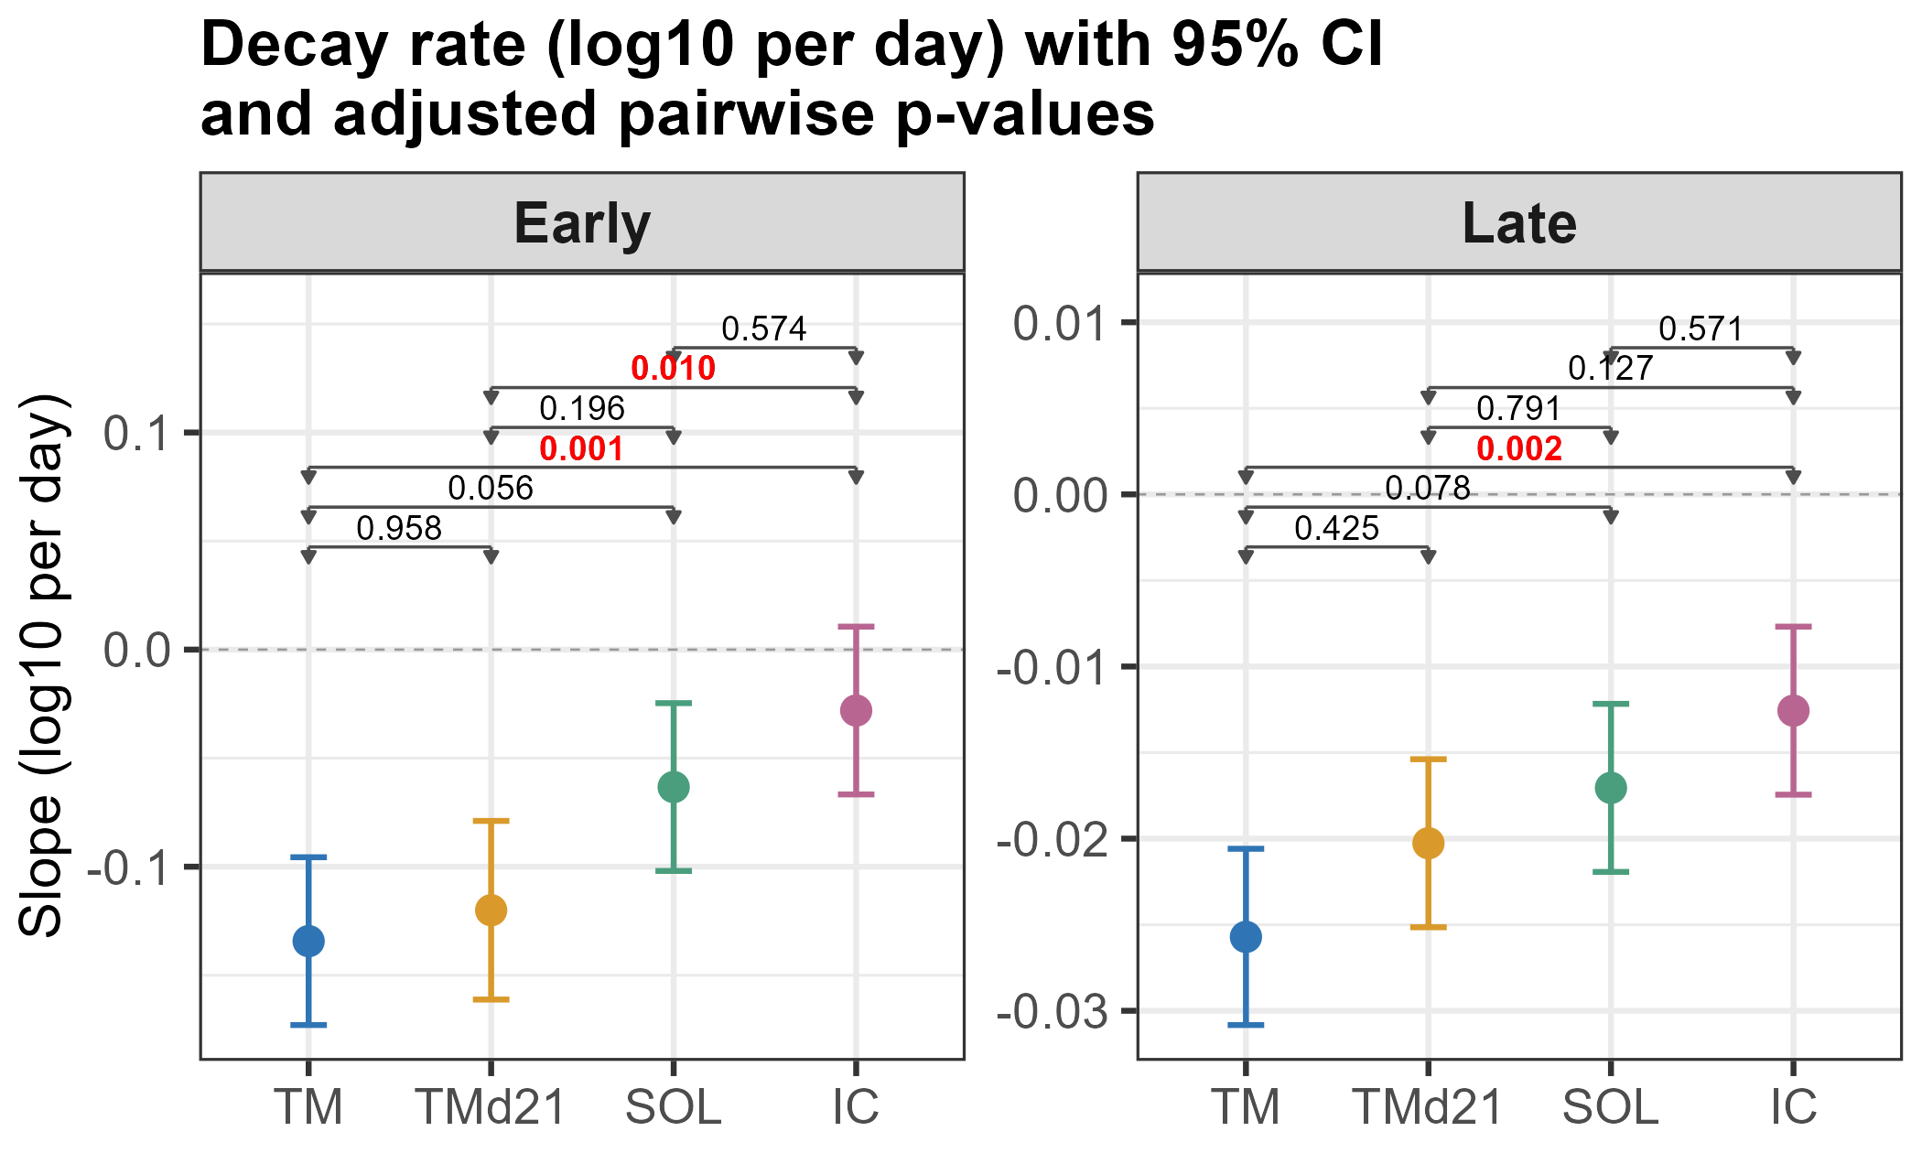
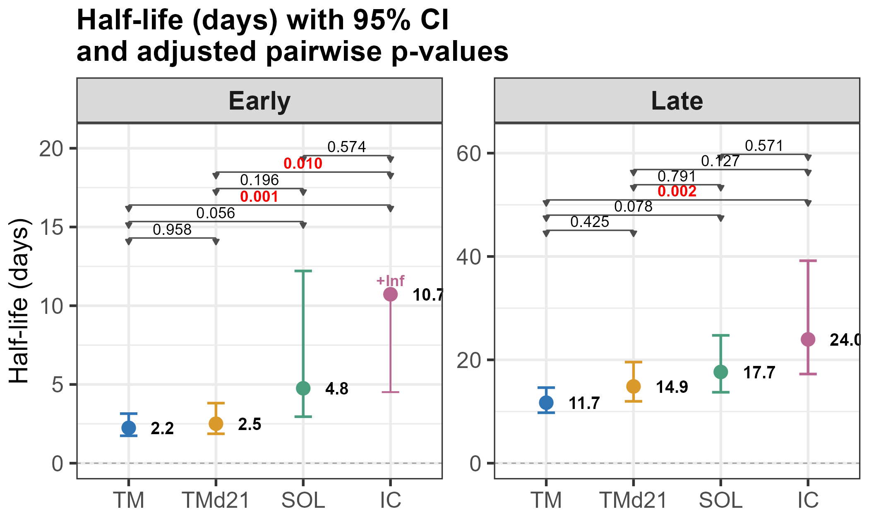
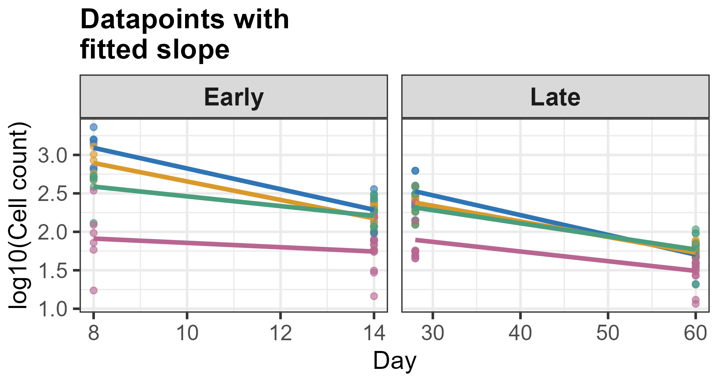
CD4 tet+ TCM_cells
Early decay:
TM vs IC
Tmd21 vs IC
Late decay:
TM vs IC

Slide 12
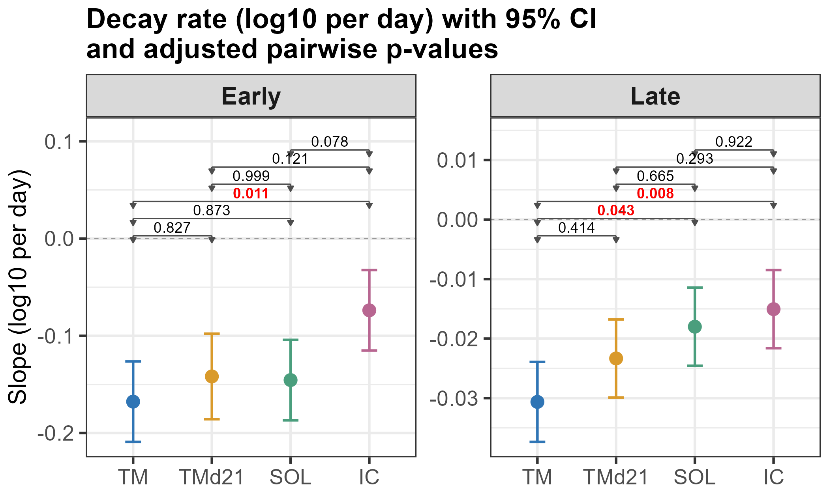
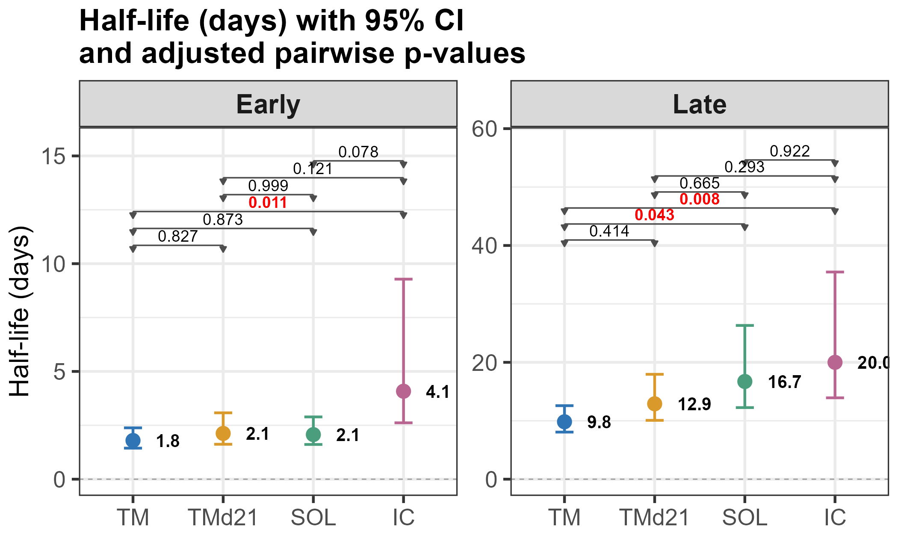
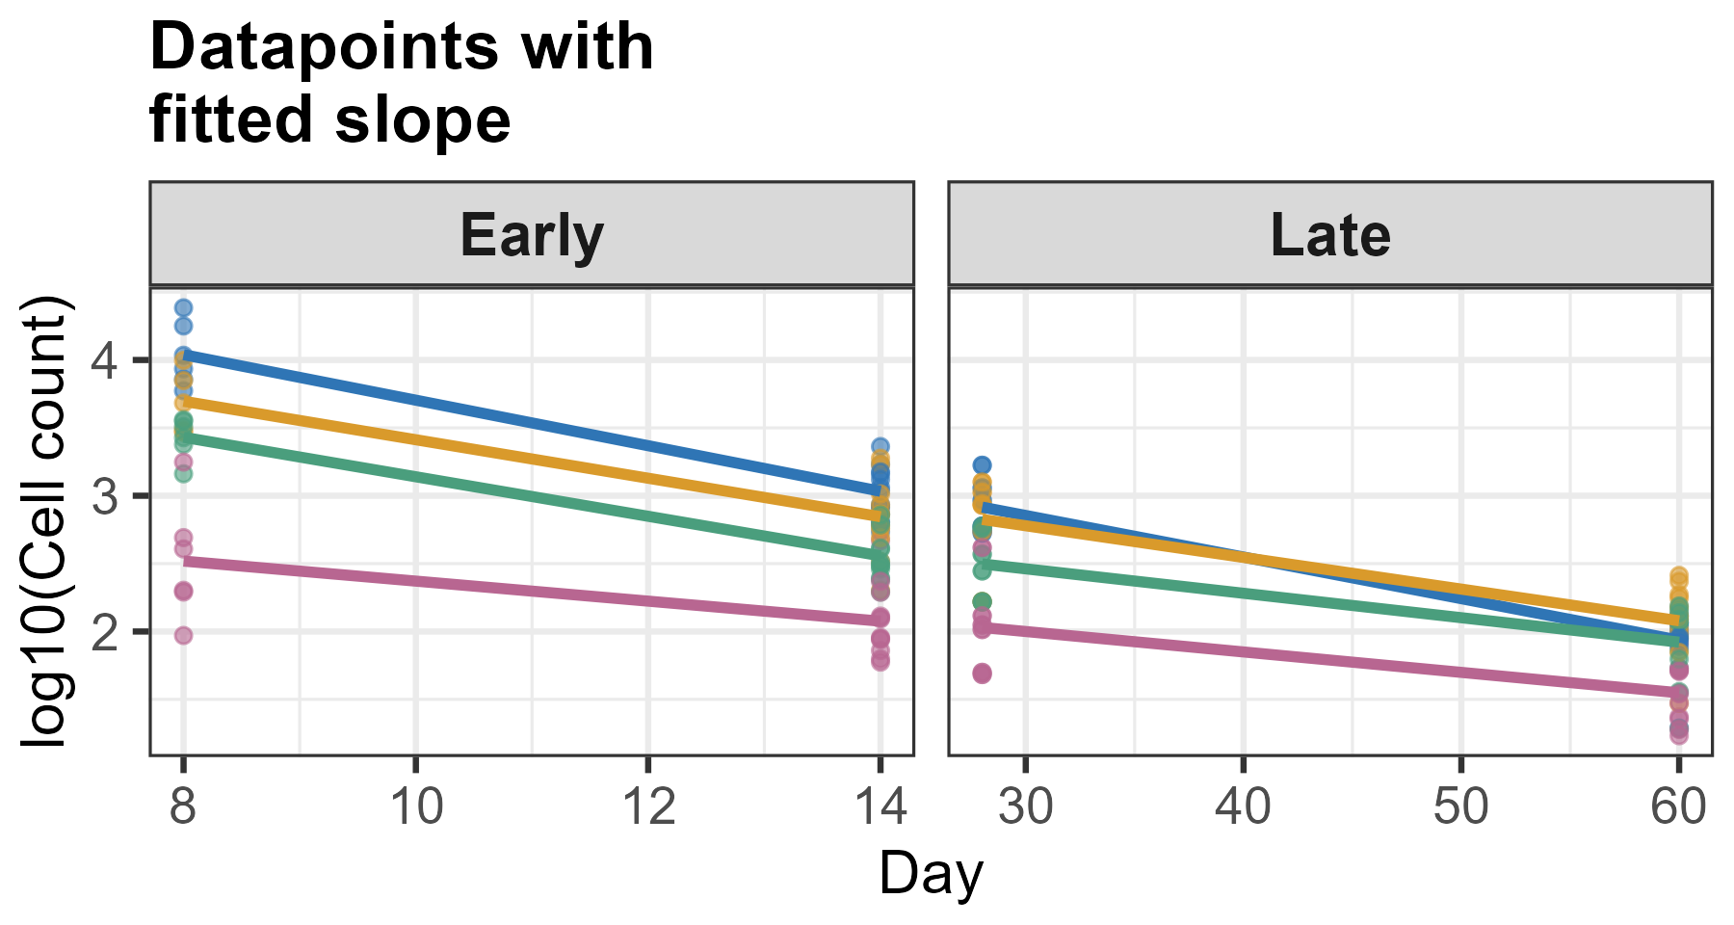
CD4 tet+ TEM_cells
Early decay:
TM vs IC
Late decay:
TM vs IC
TM vs SOL

Slide 13
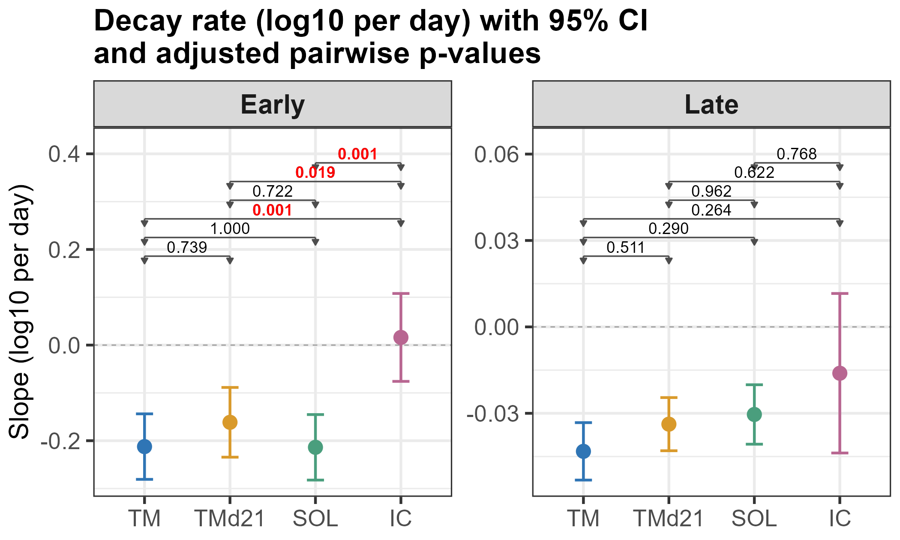
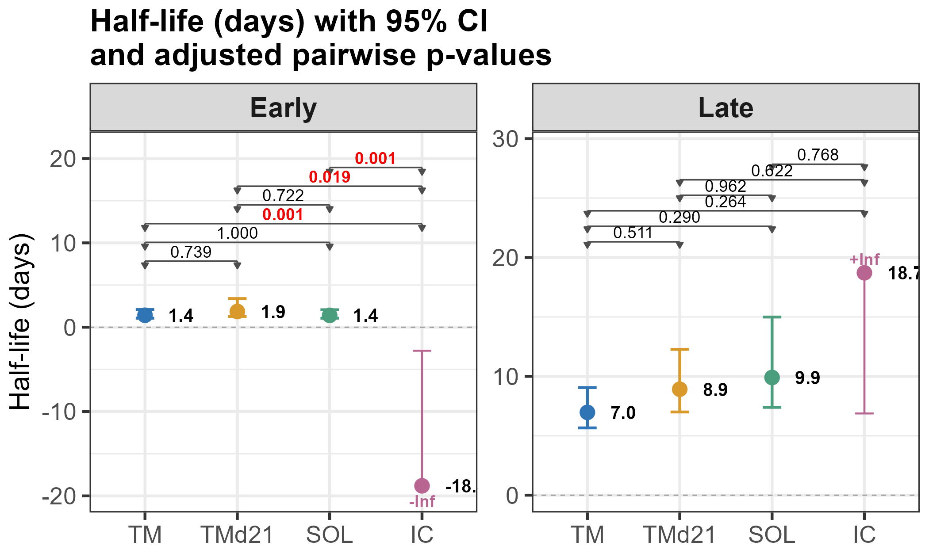
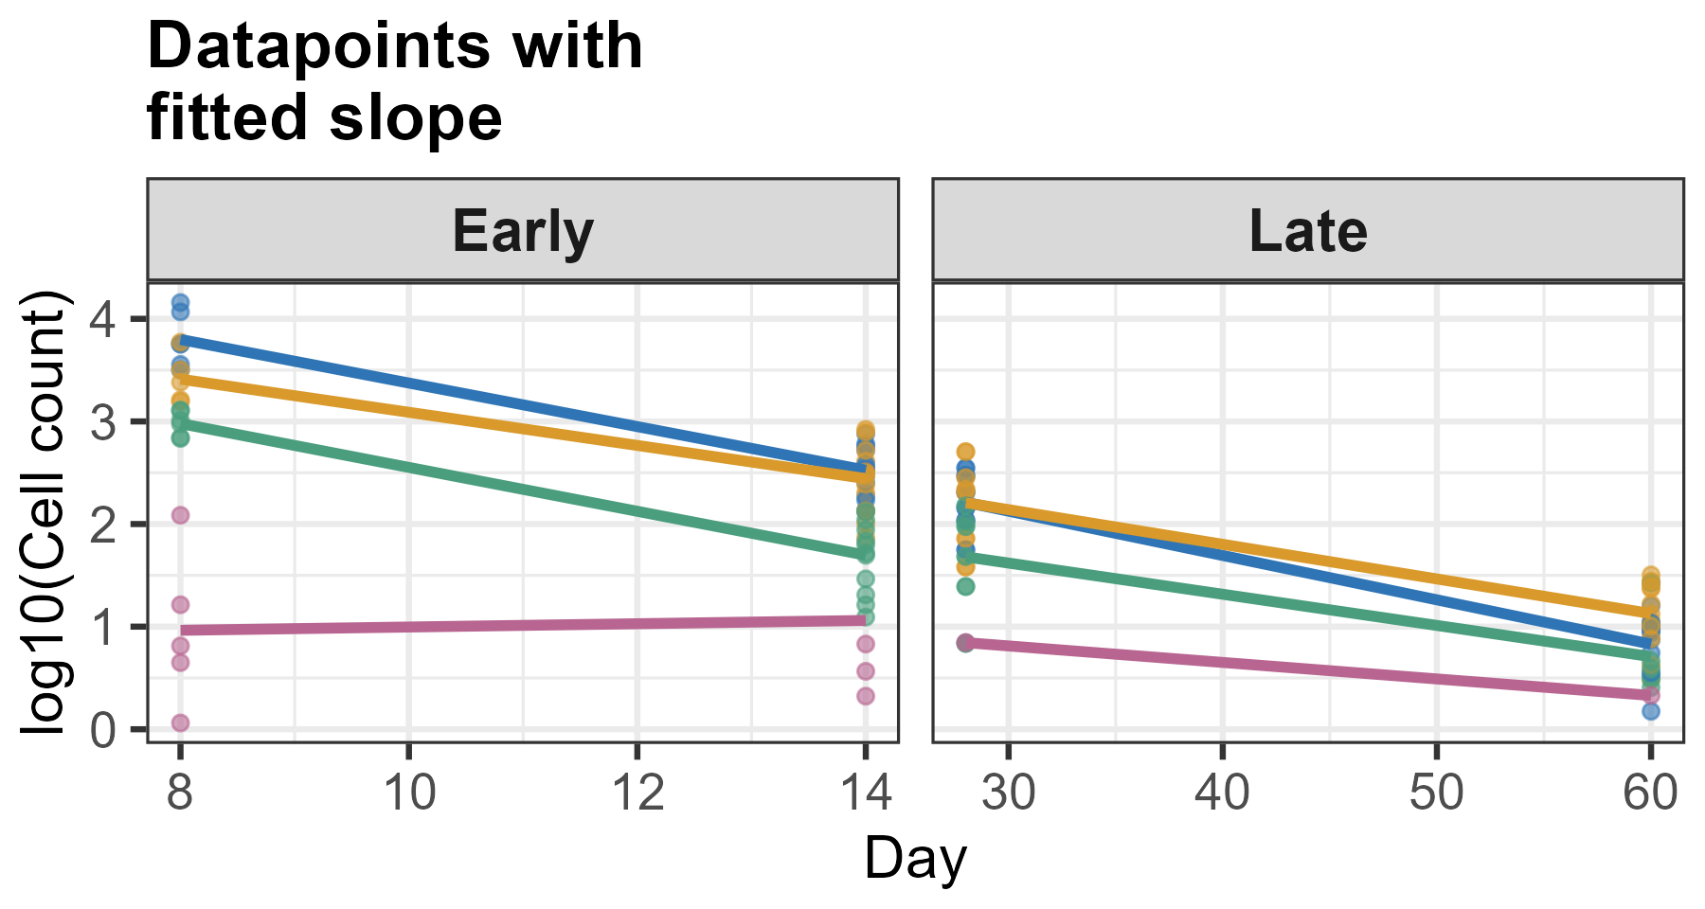
CD4 tet+ TFH_cells
Early decay:
TM vs IC
Tmd21 vs IC
SOL vs IC

Slide 14
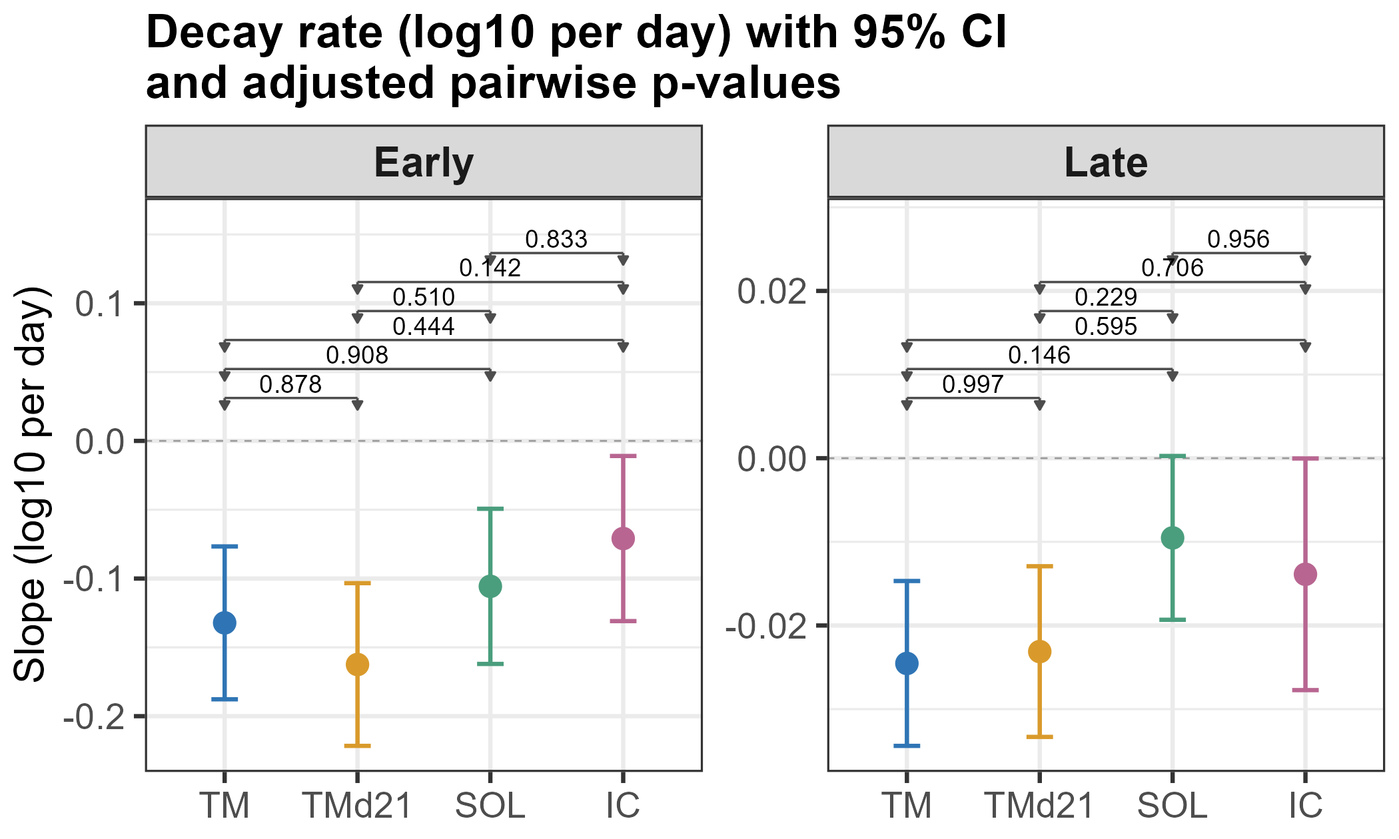
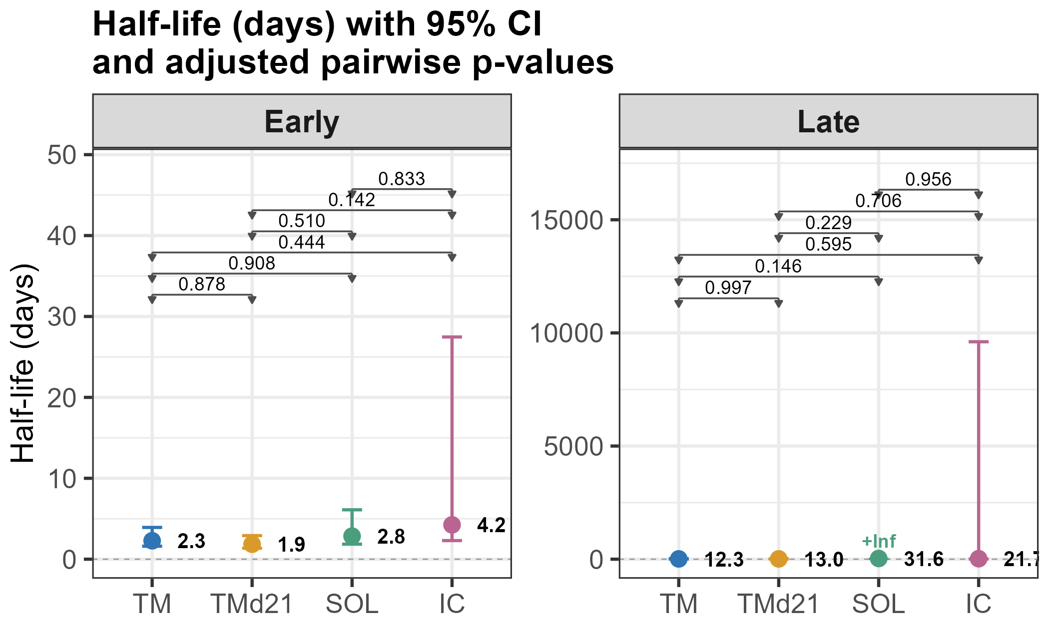
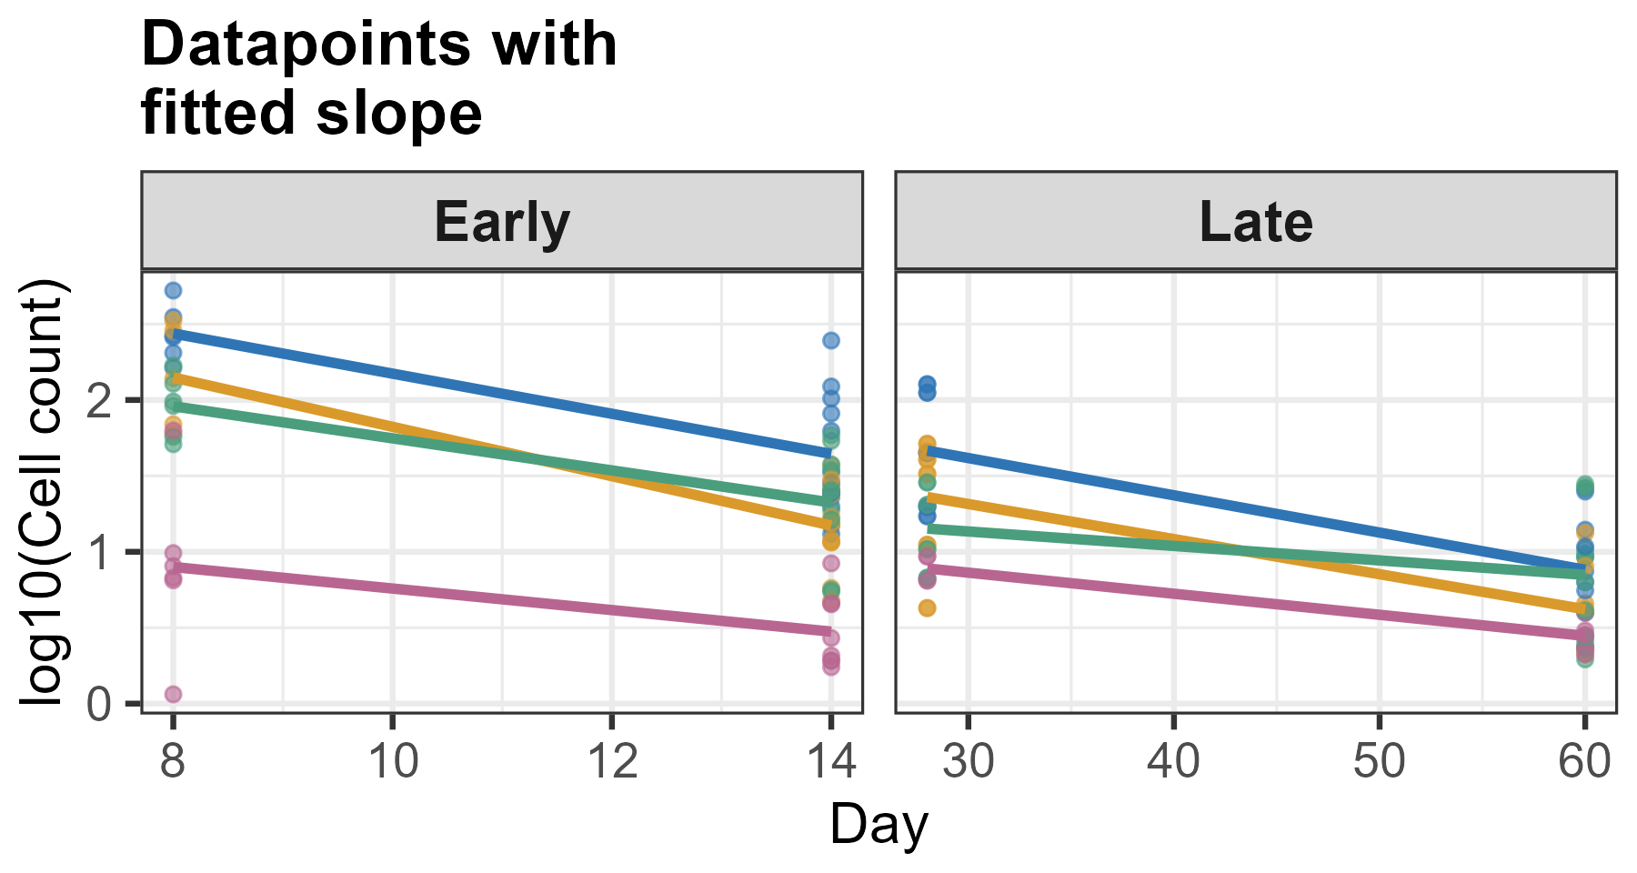
CD4 tet+ Th1_cells

Slide 15
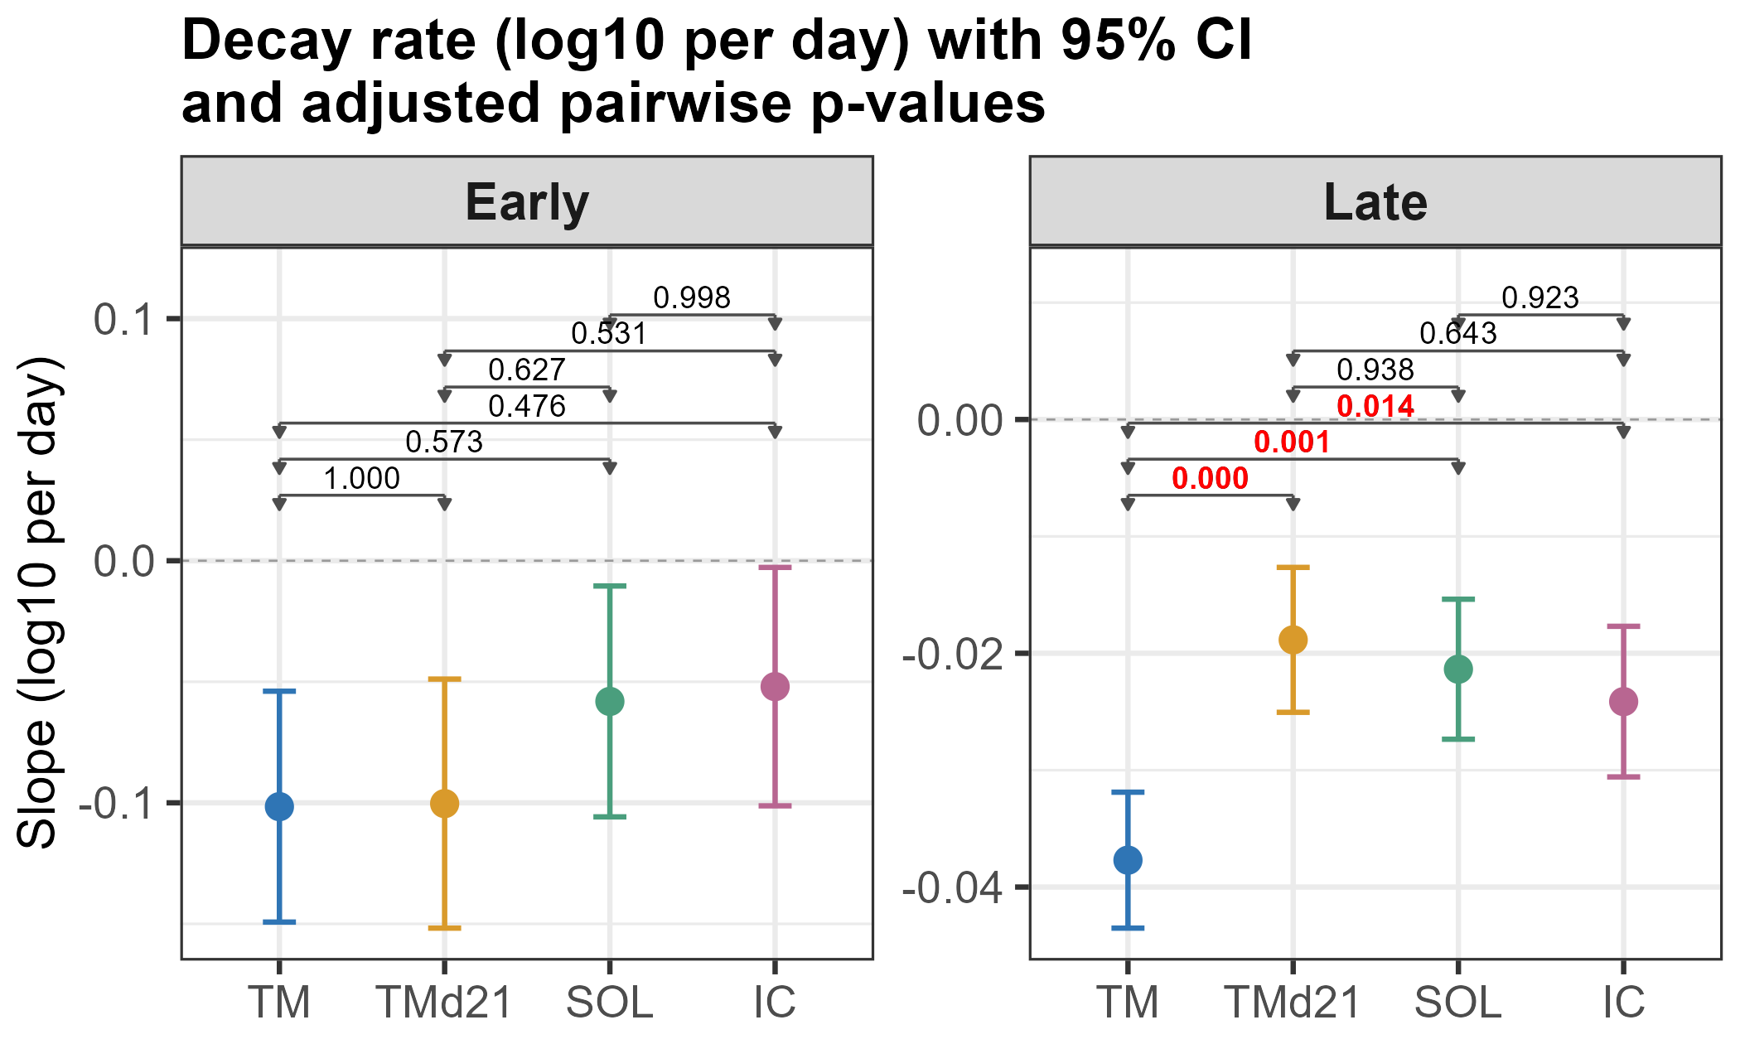
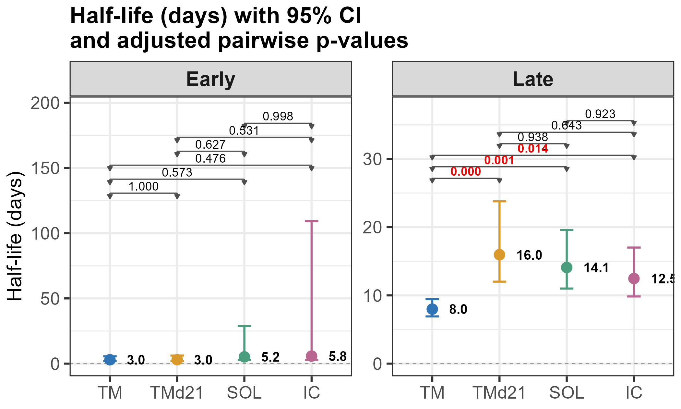
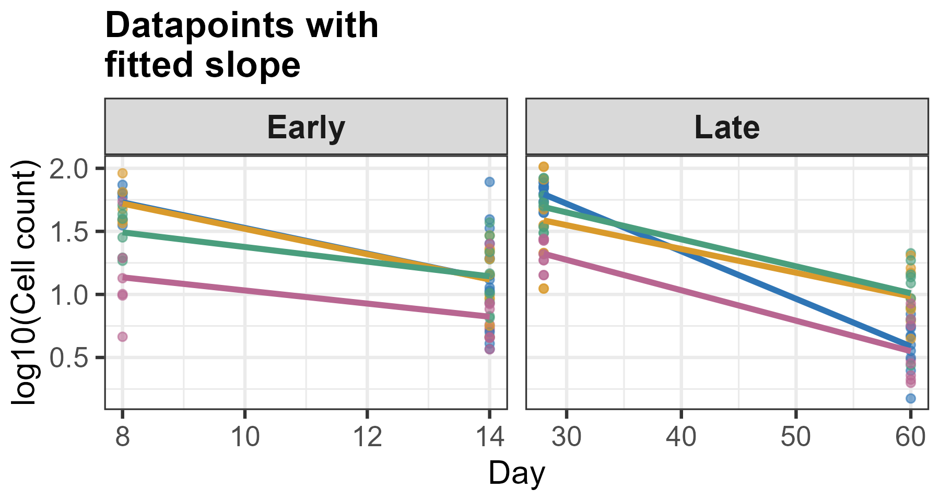
CD4 tet+ Th2_cells
Late decay:
TM vs Tmd21
TM vs SOL
TM vs IC

